Slide 1
DECORATIVE COATINGS
Overlays – Epoxies – Stains – Sealers
COUNTERTOPS
TABLE TOPS
VANITIES
INTERIOR - EXTERIOR FLOORS
INTERIOR - EXTERIOR WALLS
3D & ART
Residential – Commercial -- Industrial

Slide 2
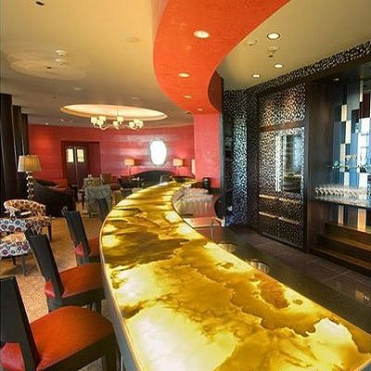
Custom Commercial Tops
Backlight Onyx

Slide 3
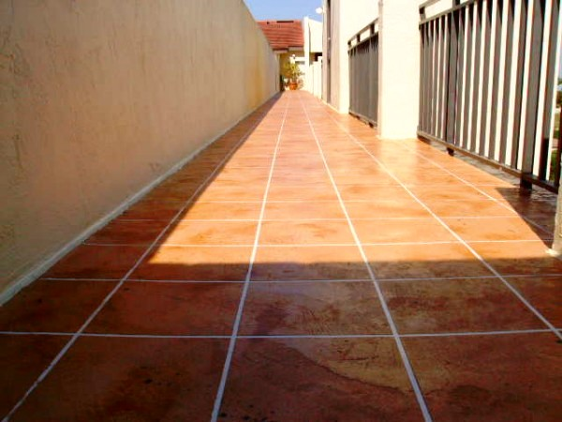
Custom Floor Overlays
Apartment Complexes

Slide 4
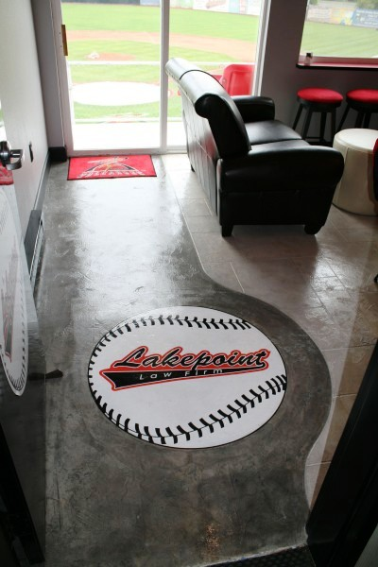
Custom Floor Overlays
Ballpark Suites

Slide 5
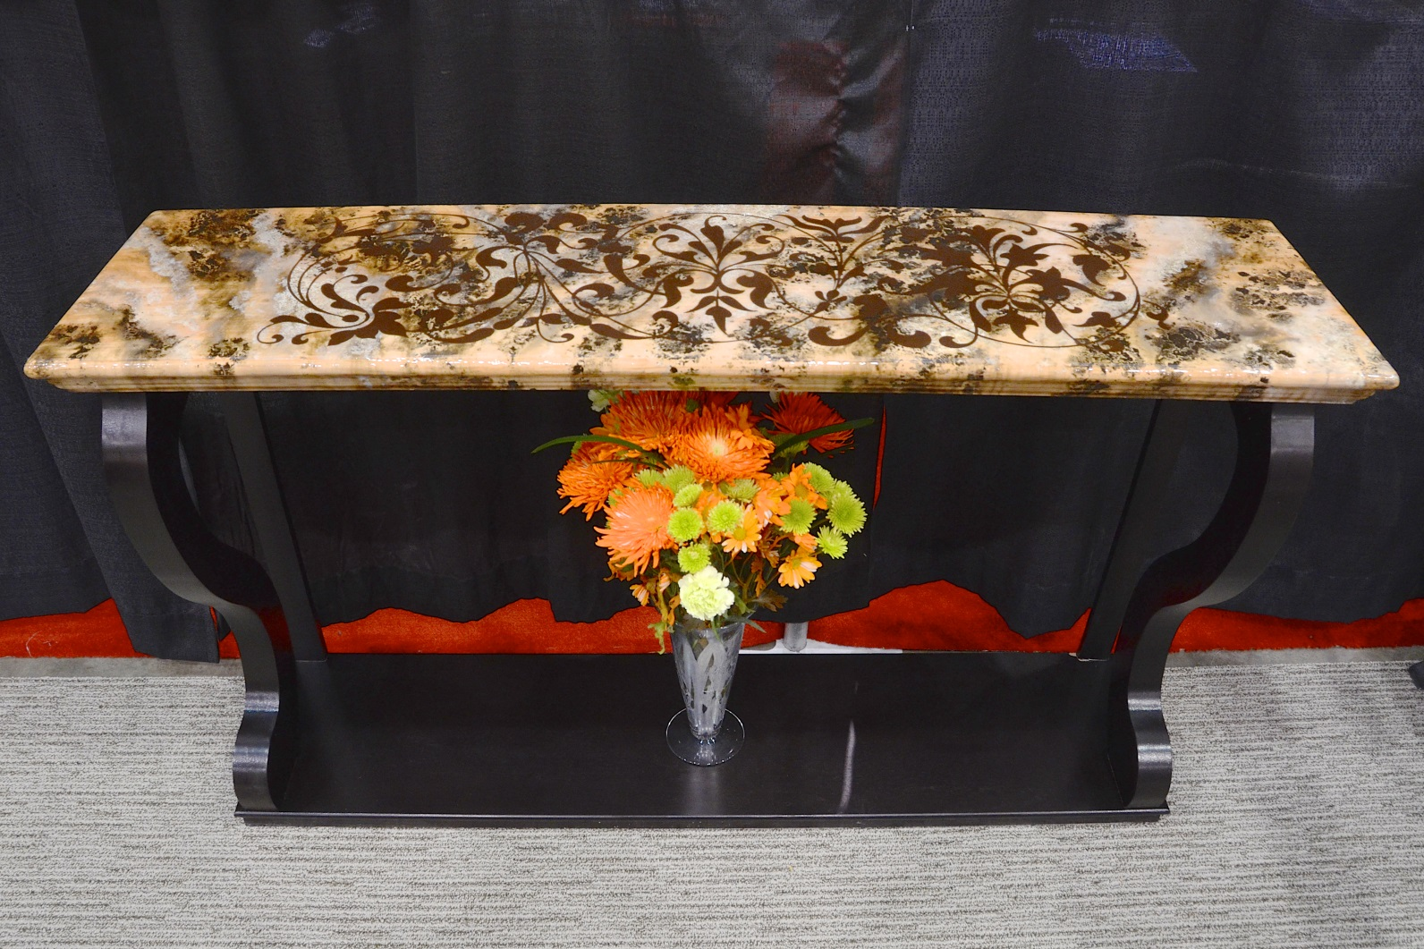
Custom Tables
Stone Finish Credenza

Slide 6
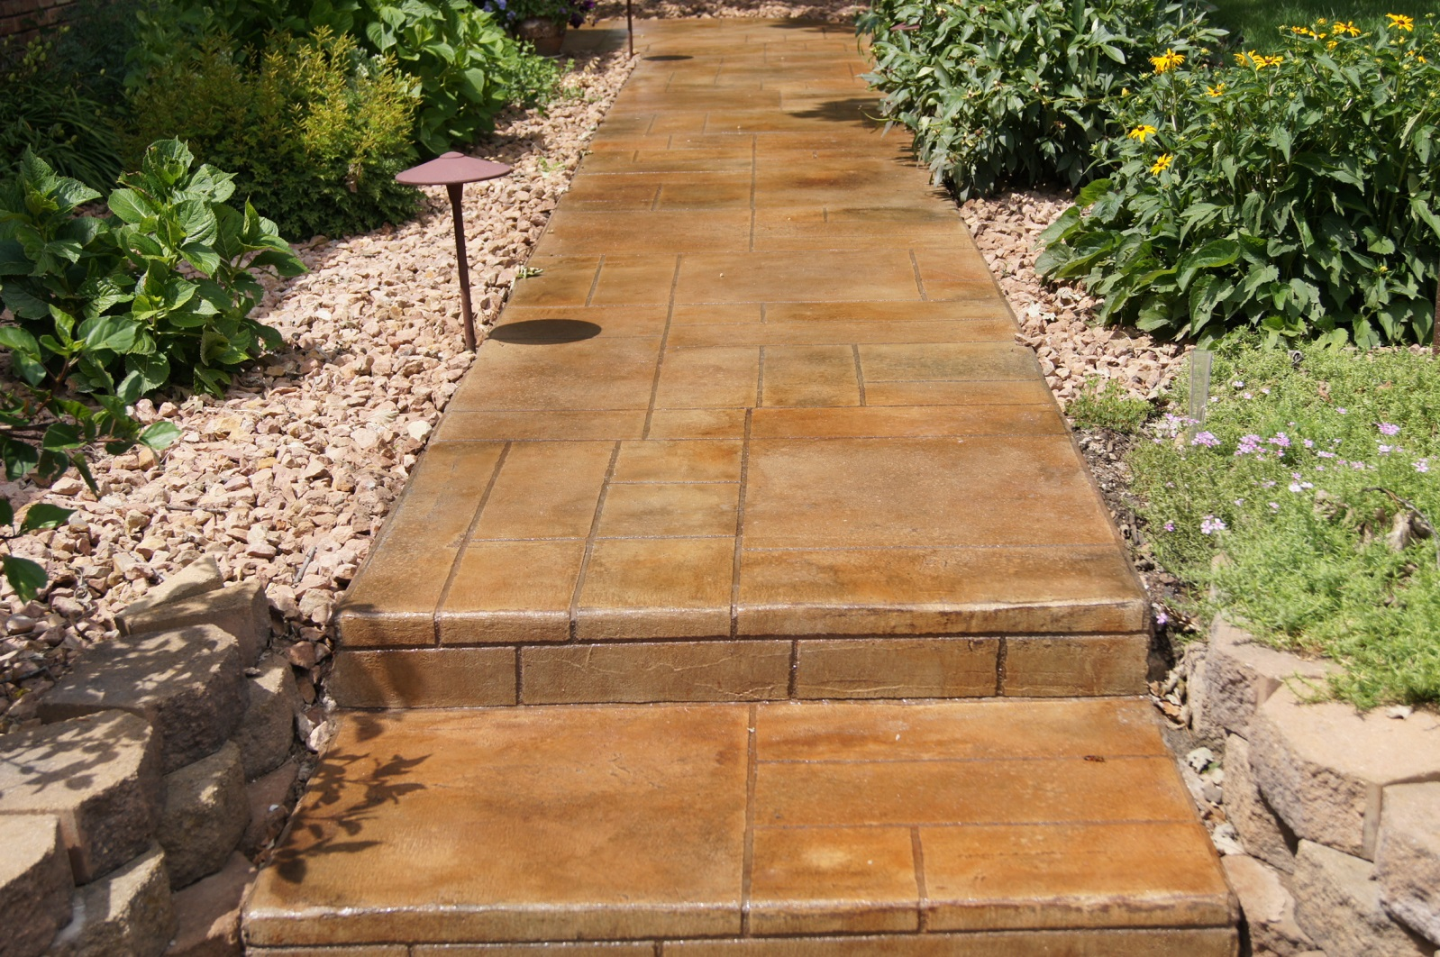
Custom Floor Overlays
Park Walkways

Slide 7
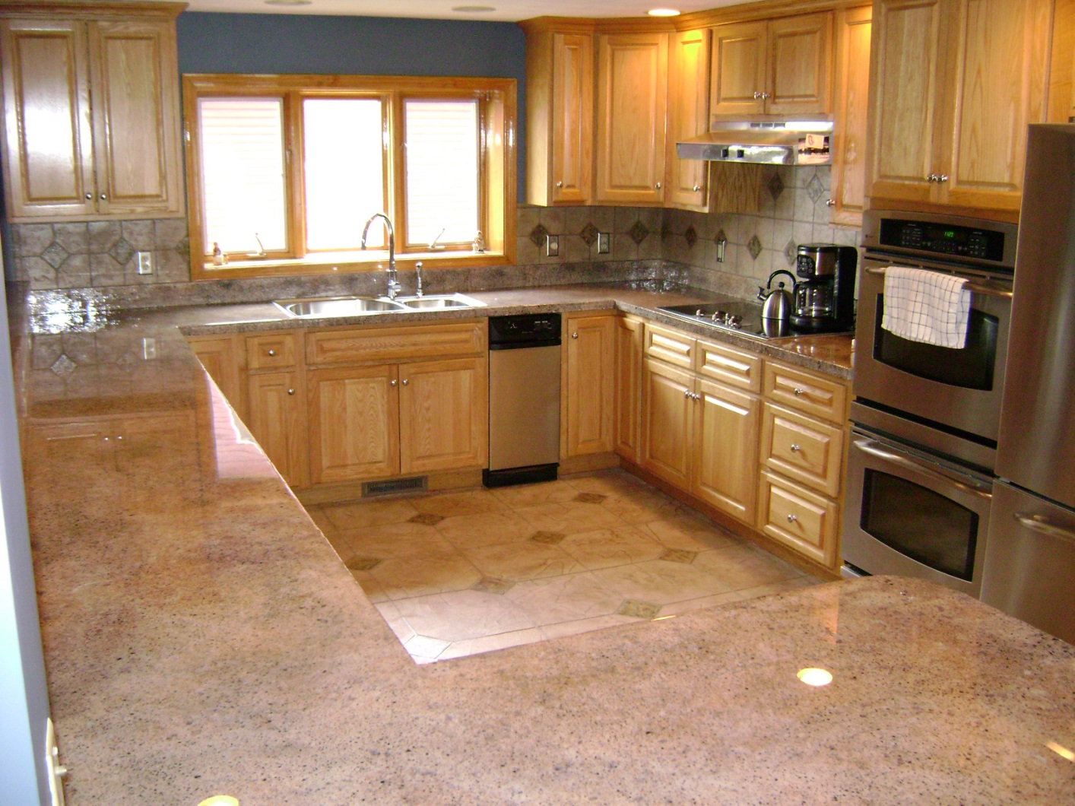
Custom Countertops
Entire Kitchen Makeover

Slide 8
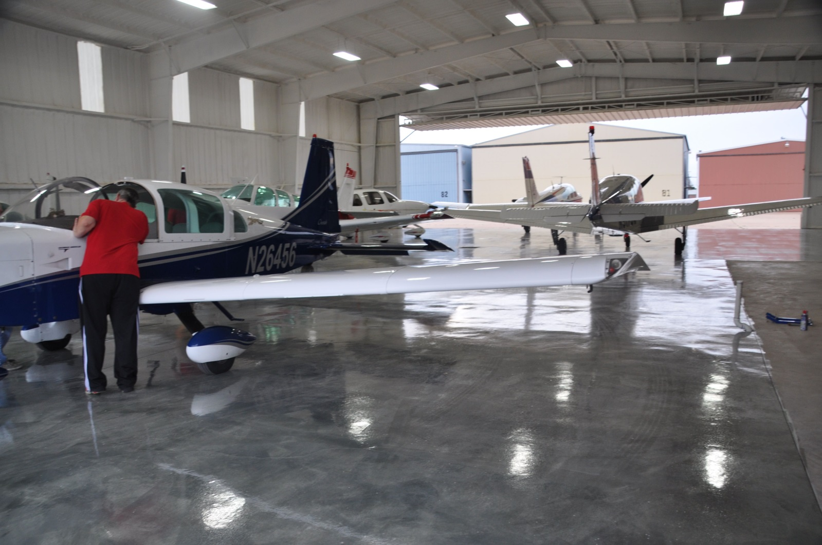
Real MetalliX Epoxy Floors
MetalliX - Largest in USA

Slide 9
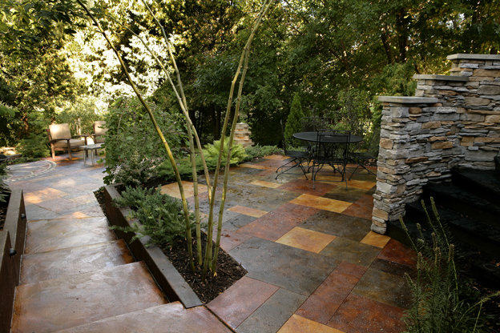
Custom Floor Overlays
Garden Paths

Slide 10
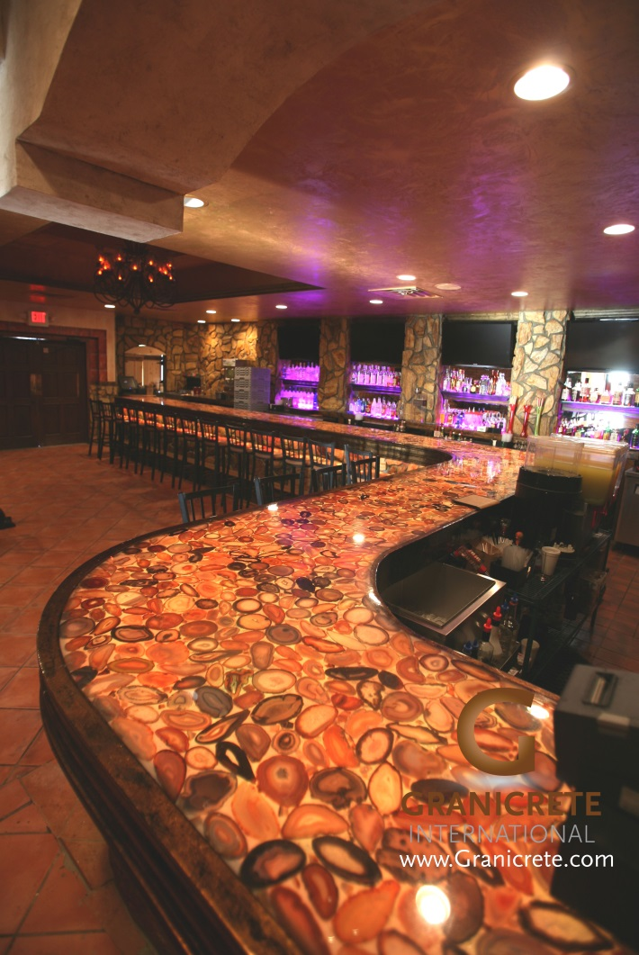
Custom Commercial Tops
Stunning Bar Tops

Slide 11
Exterior Floor Overlays
Custom Front Walkway

Slide 12
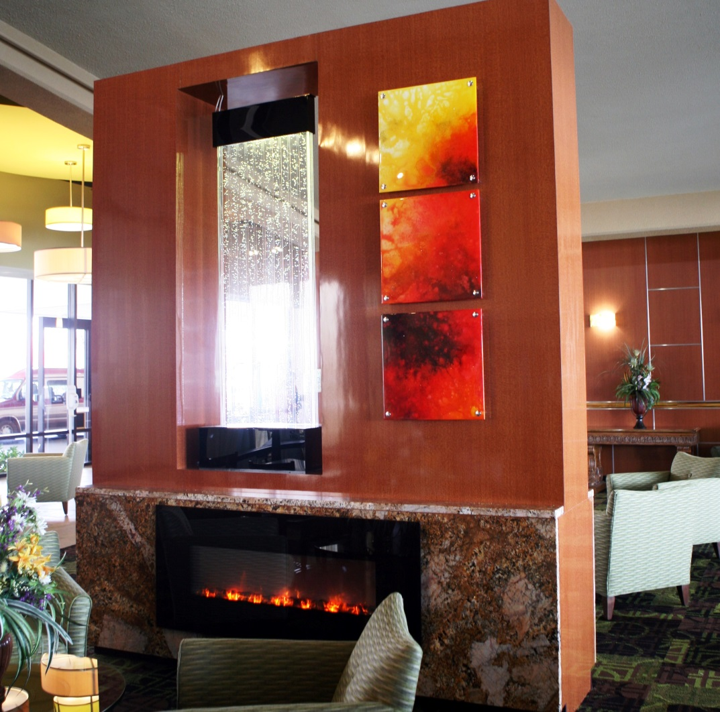
Wall Art
Custom Wall Art

Slide 13
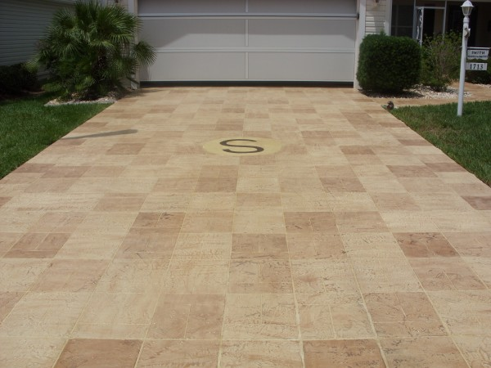
Exterior Floor Overlays
Custom Driveways

Slide 14
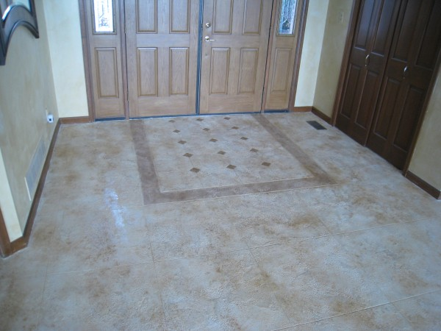
Custom Interior Overlays
Interior Entry

Slide 15
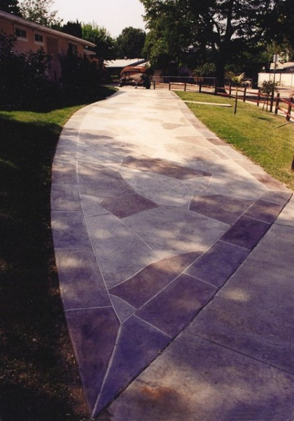
Custom Floor Overlays
Park Walkways

Slide 16
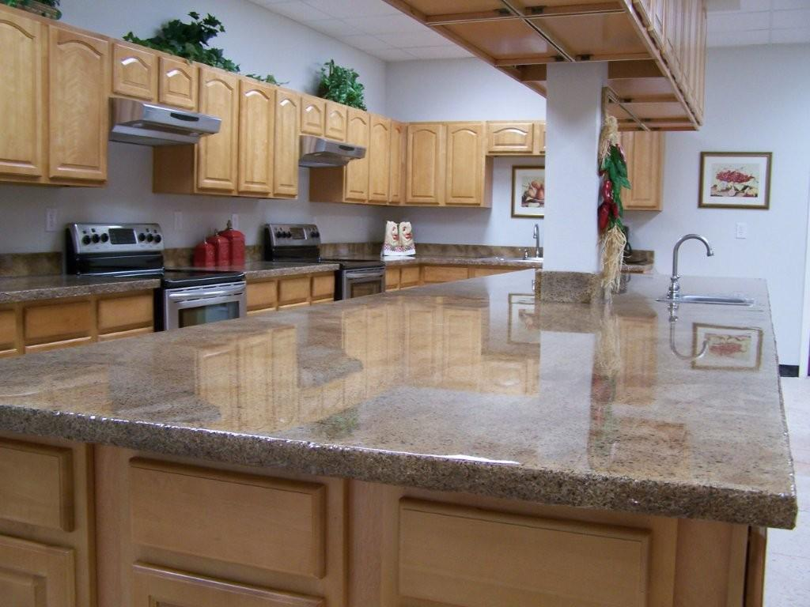
Custom Commercial Tops
Service Kitchens

Slide 17
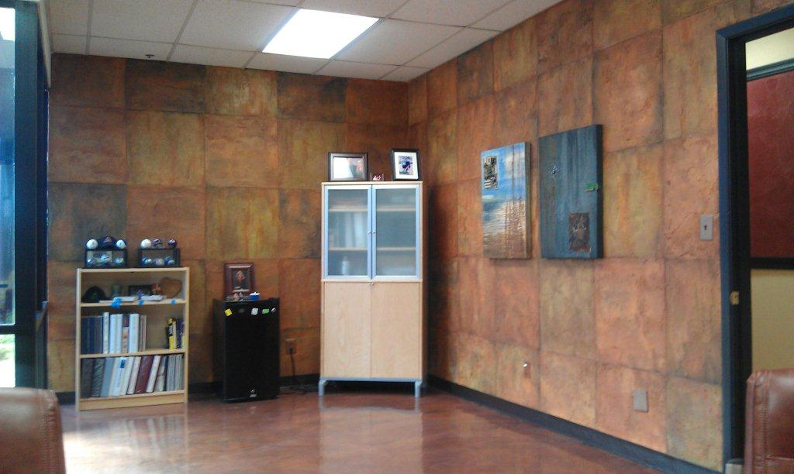
Custom Wall Finishes
Slate Office Wall

Slide 18
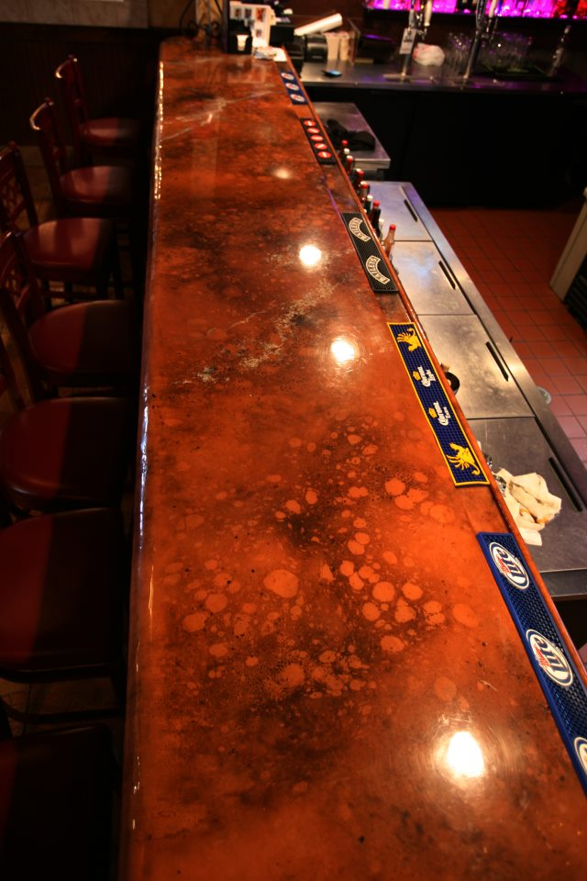
Custom Commercial Tops
Ultimate Bar Tops

Slide 19
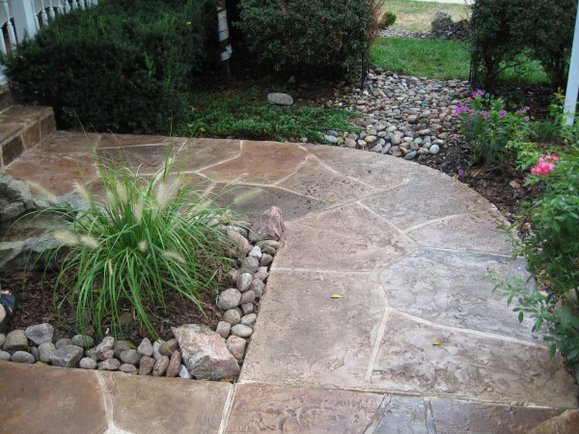
Exterior Floor Overlays
Curb Appeal At Front Walkway

Slide 20
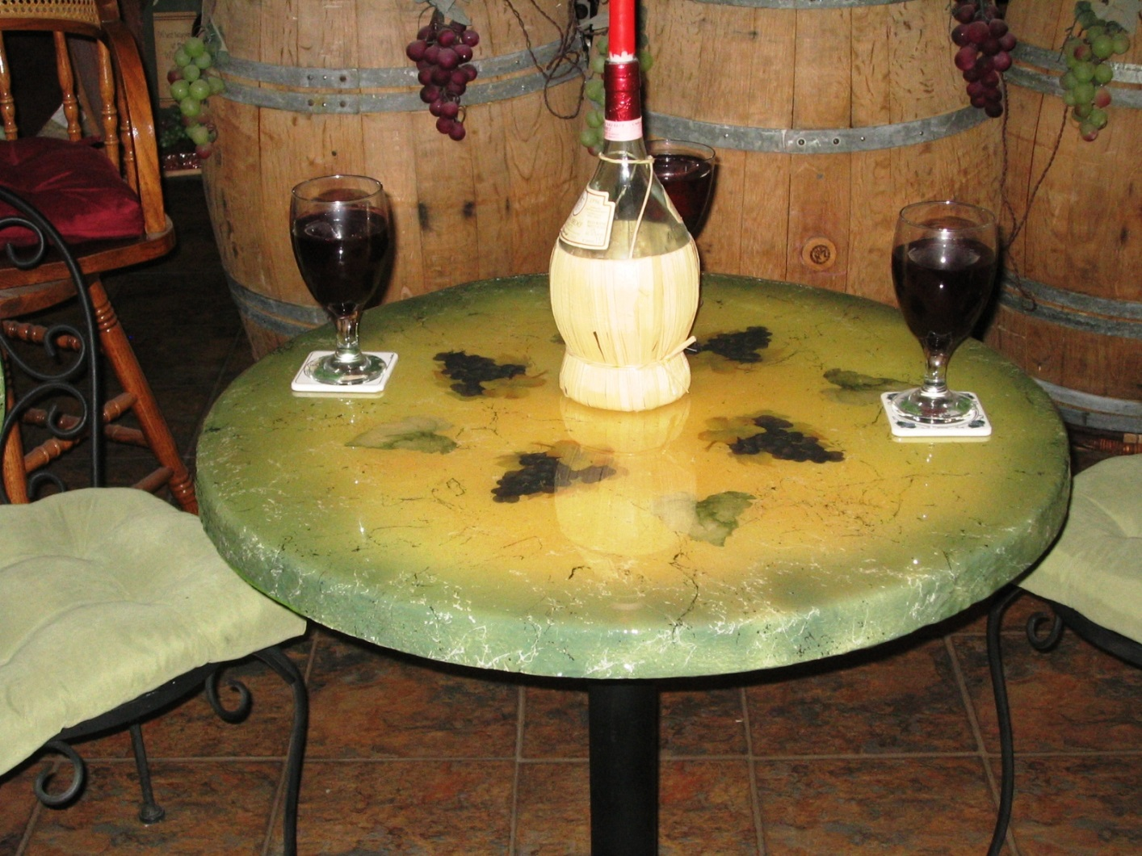
Custom Tables
Theme Tables

Slide 21
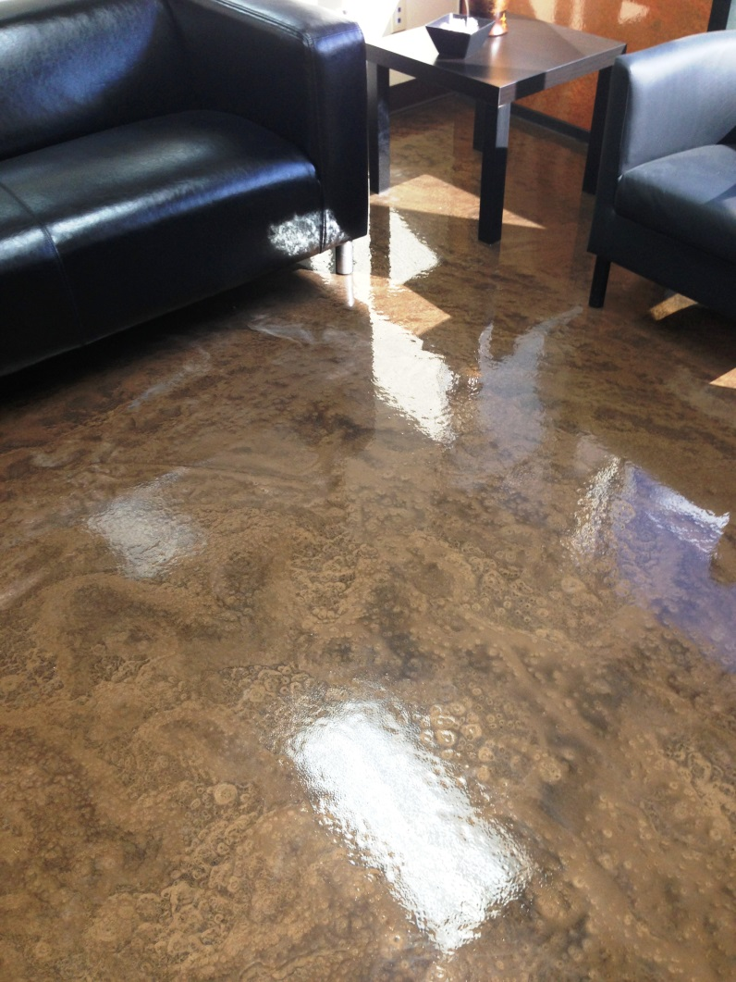
Real MetalliX Epoxy Floors
Real MetalliX Lobby

Slide 22
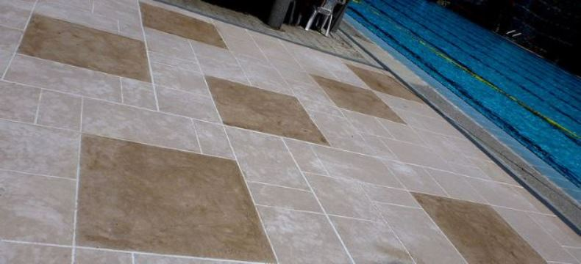
Custom Floor Overlays
Costa Rican Resorts

Slide 23
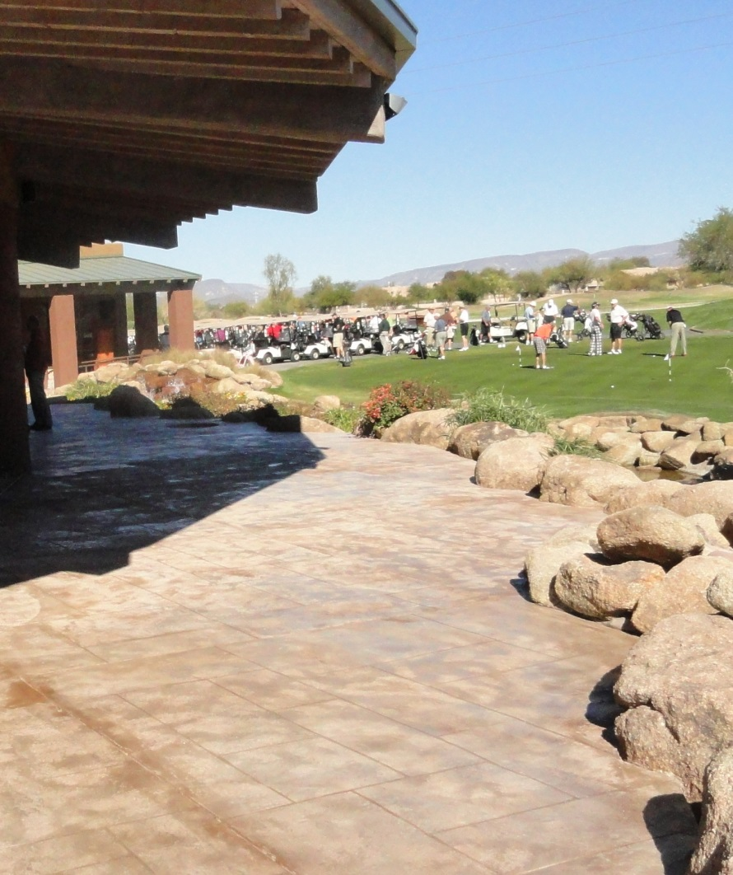
Custom Floor Overlays
Country Club Patios

Slide 24
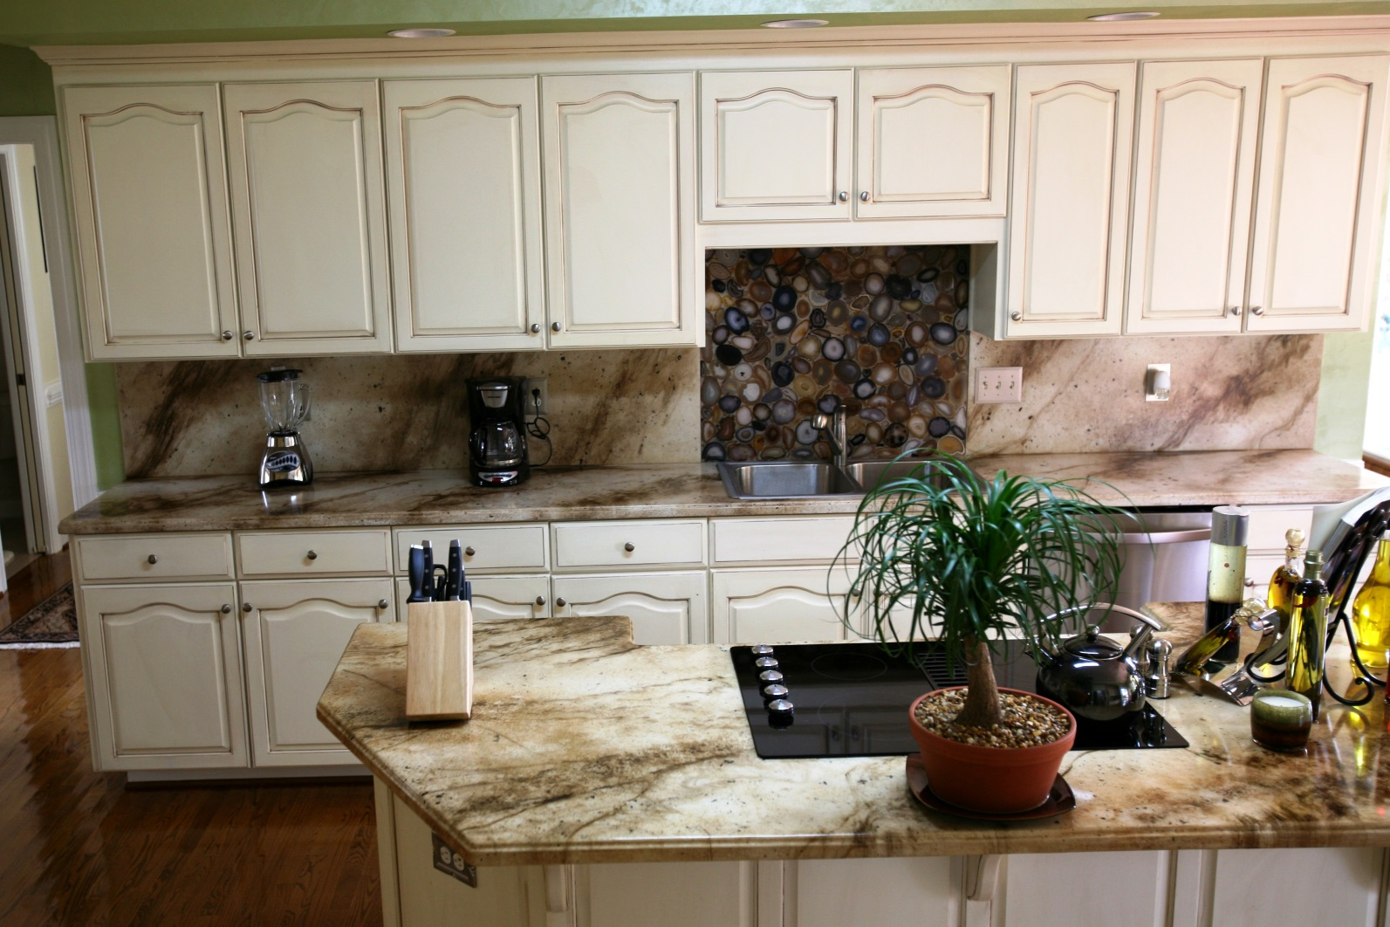
Custom Countertops
Countertops to Accent Your Kitchen

Slide 25
DECORATIVE COATINGS
Overlays – Epoxies – Stains – Sealers
COUNTERTOPS
TABLE TOPS
VANITIES
INTERIOR - EXTERIOR FLOORS
INTERIOR - EXTERIOR WALLS
3D & ART
Residential – Commercial -- Industrial

Slide 26
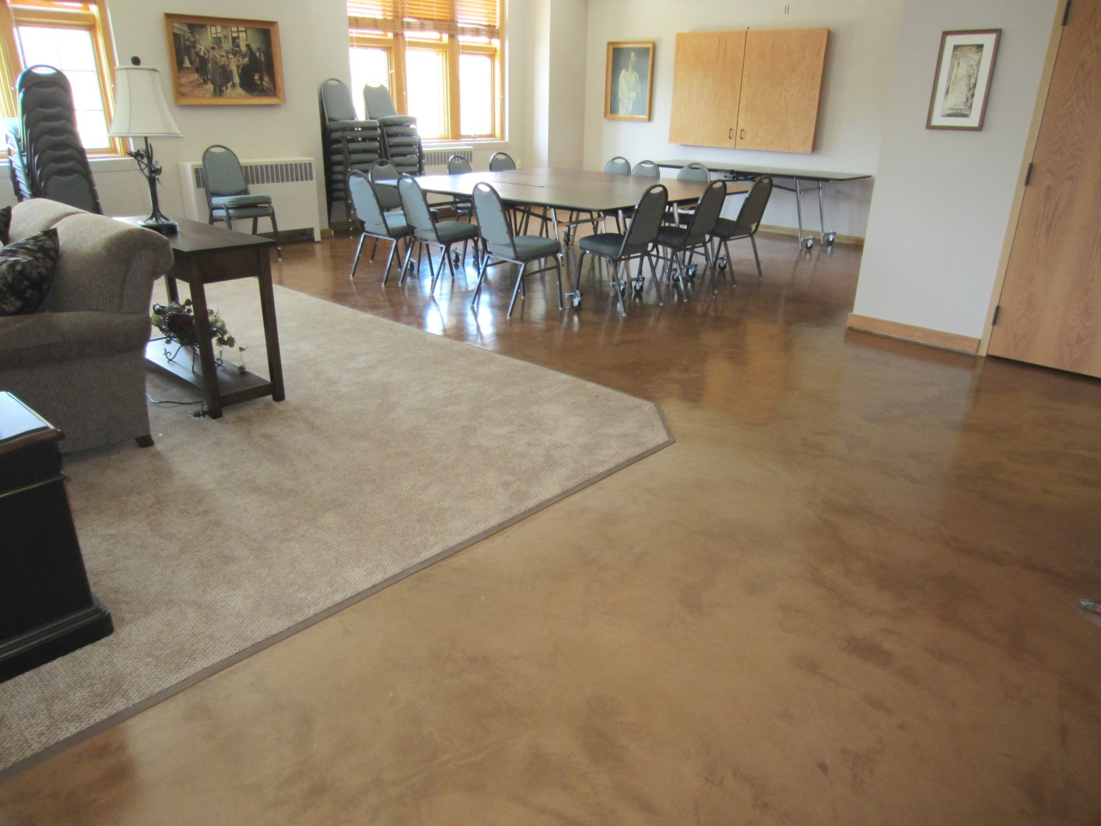
Custom Micro-Toppings
Easy Care Micro-Topping Floors

Slide 27
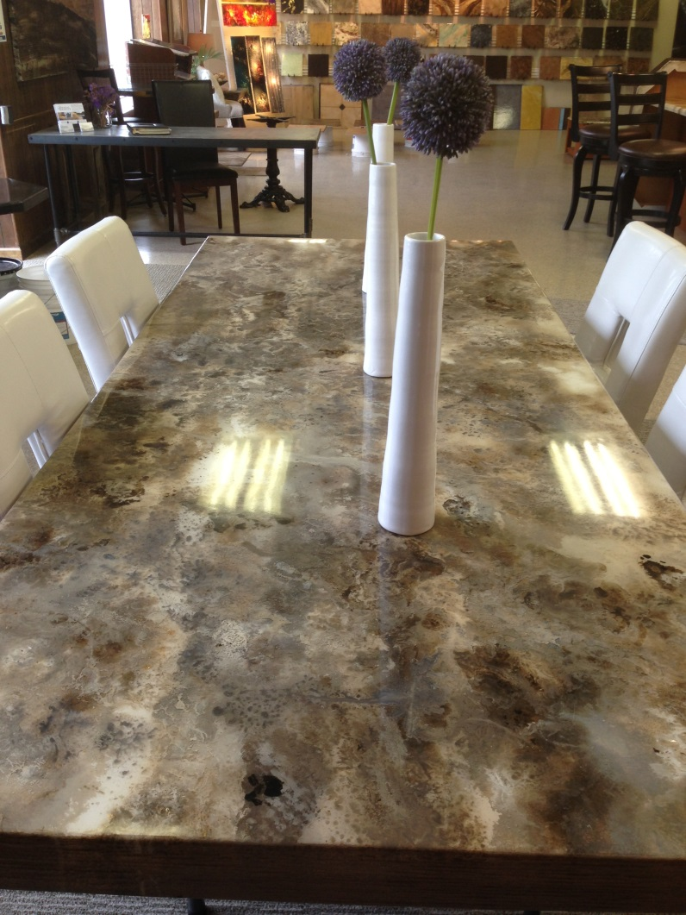
Custom Tables
Handcrafted Stone Finish

Slide 28
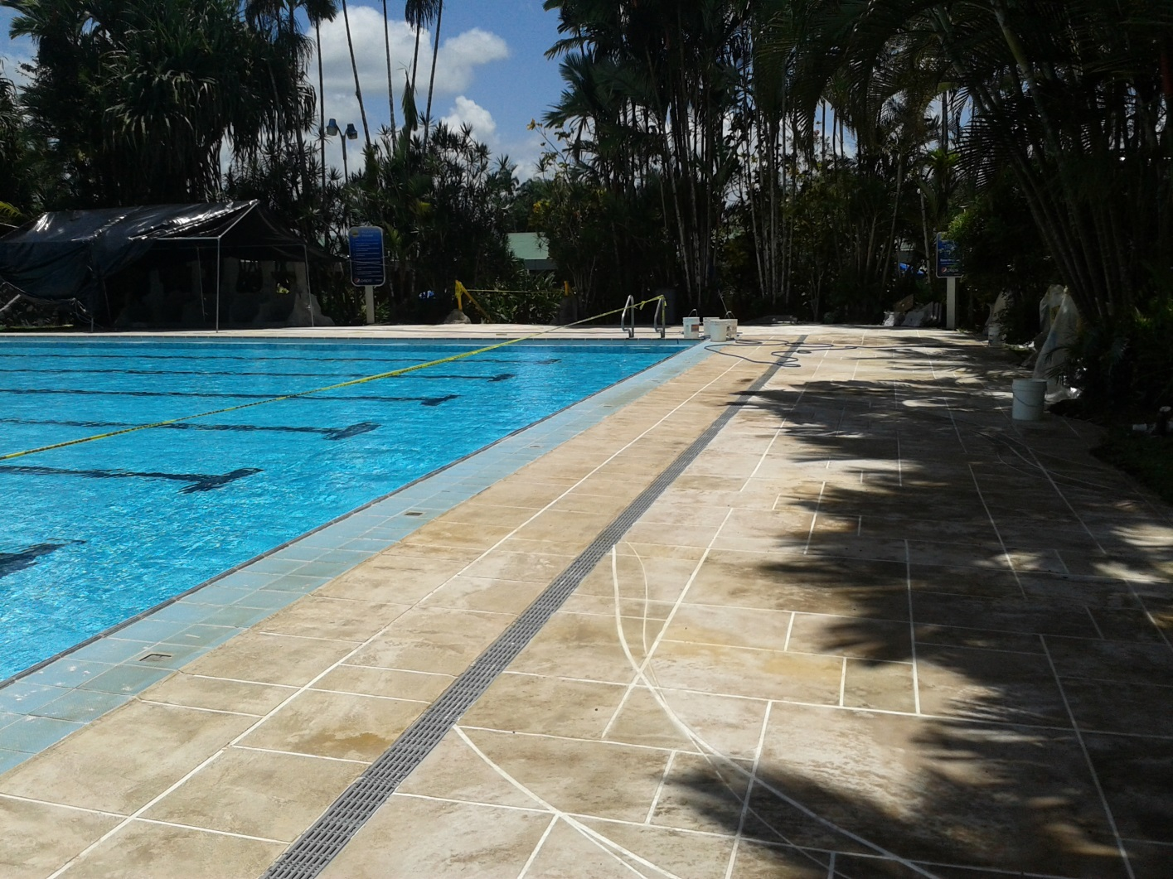
Custom Floor Overlays
Exterior Floor Overlay - Cool on the Foot

Slide 29
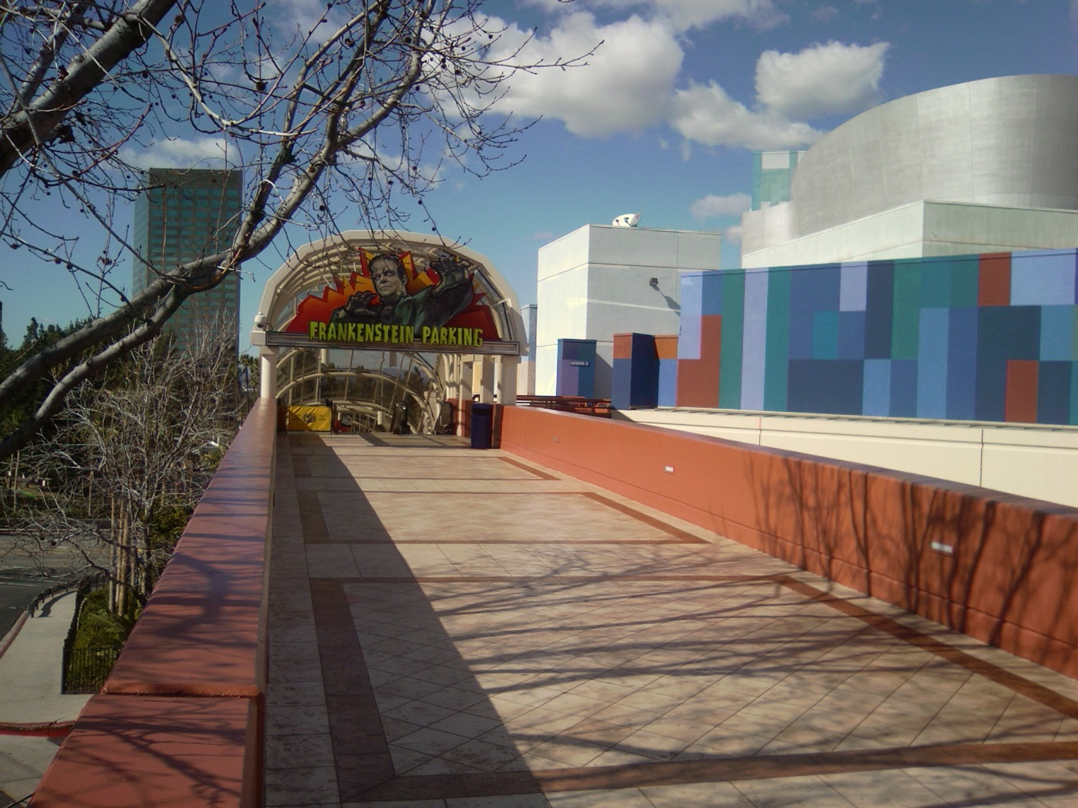
Custom Floor Overlays
Exterior Floor Overlay @ Universal Studios

Slide 30
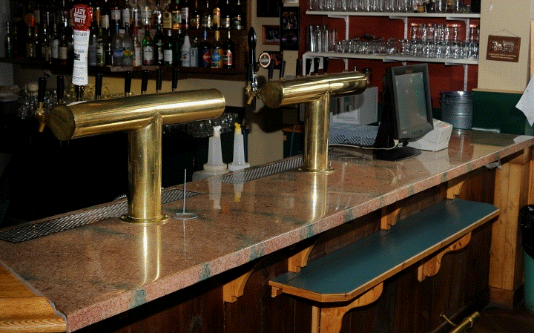
Custom Commercial Tops
Commercial Bar Tops

Slide 31
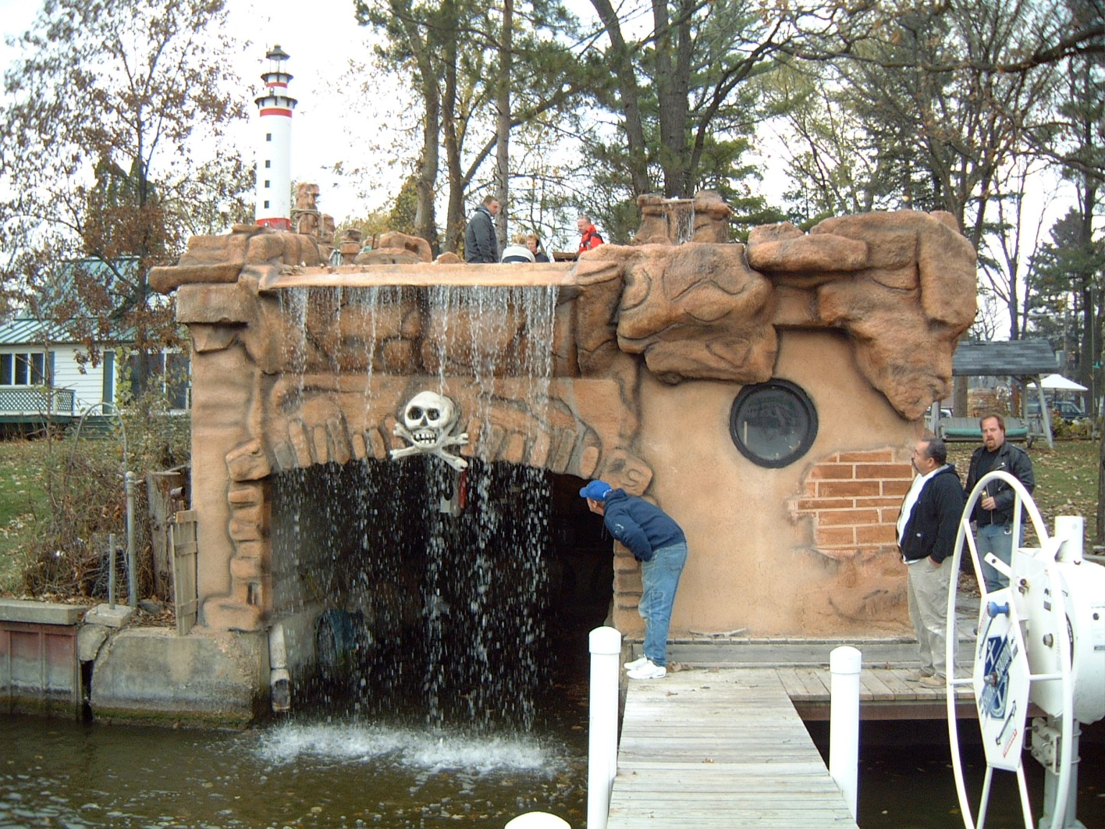
Custom 3D Finishes
Overlay and Colors for Fun!

Slide 32
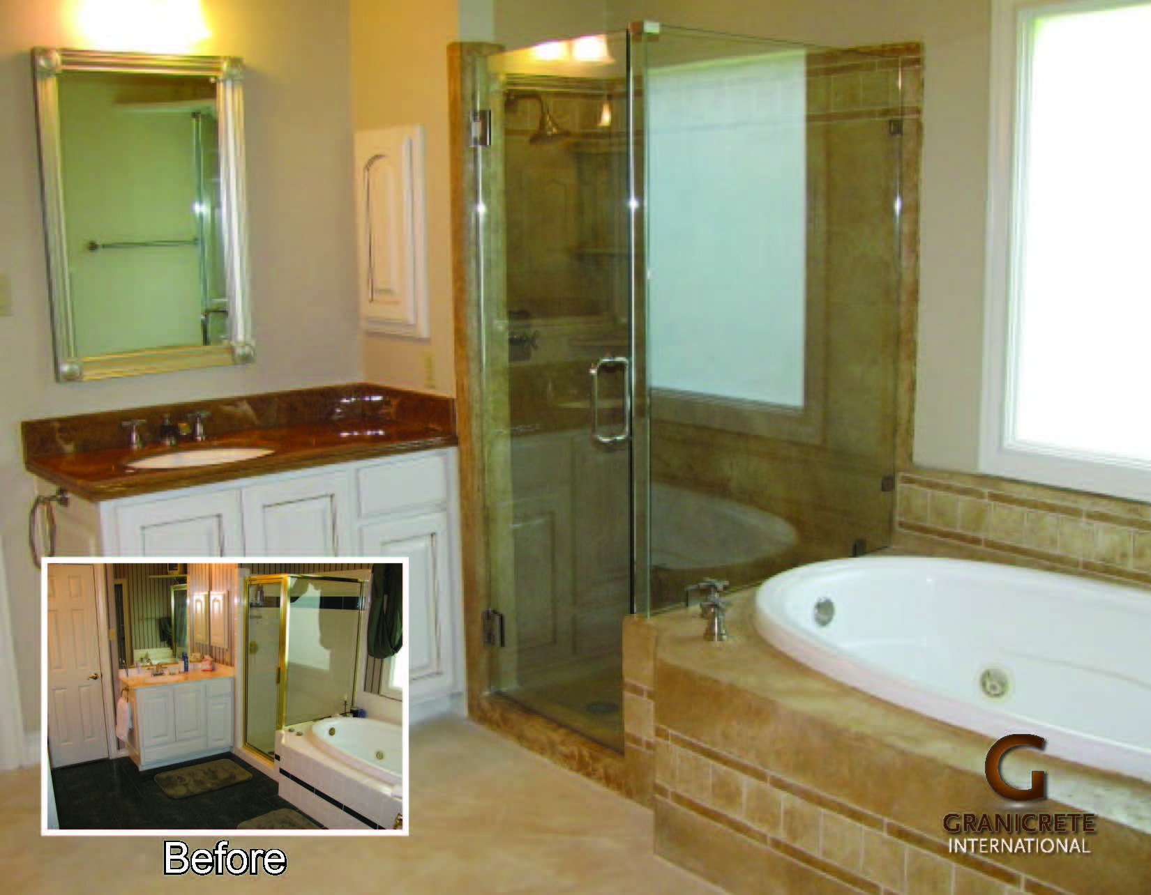
Bathroom Makeovers
Bath Remodel and Resurfacing

Slide 33
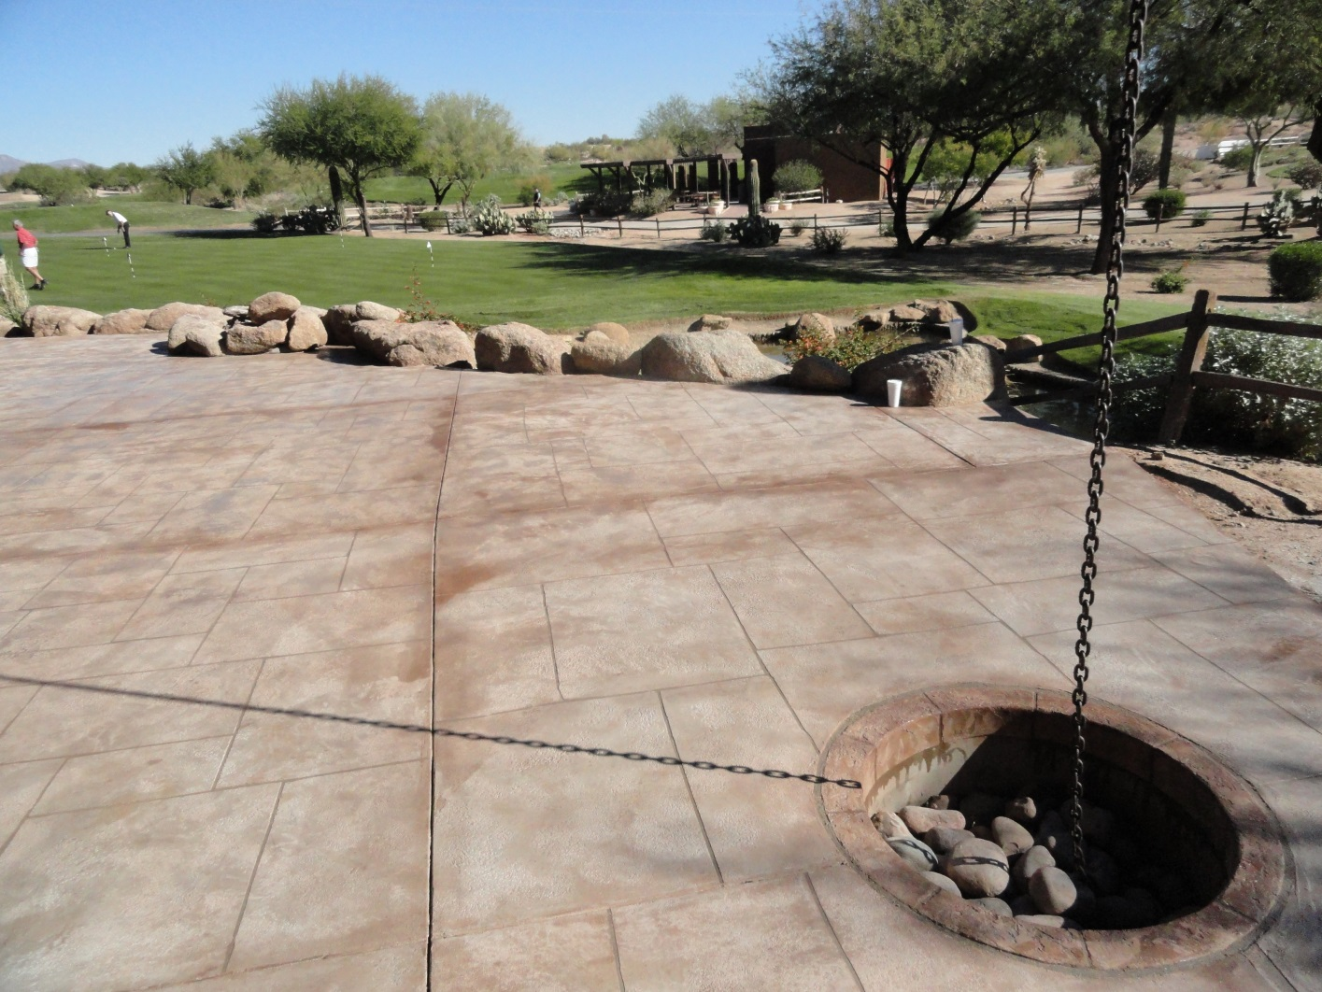
Custom Floor Overlays
Gold Course Patios

Slide 34
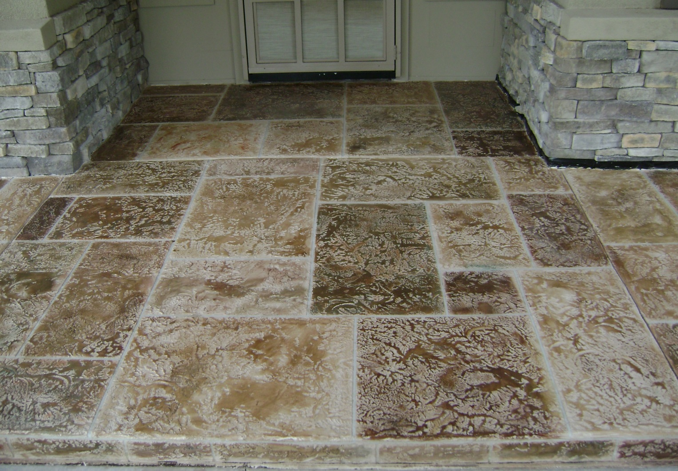
Custom Floor Overlays
Impress Your Client From The Curb

Slide 35
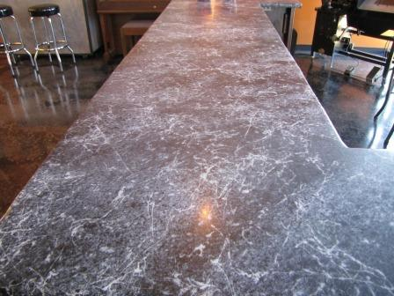
Custom Commercial Tops
Marble Nero Bar Tops

Slide 36
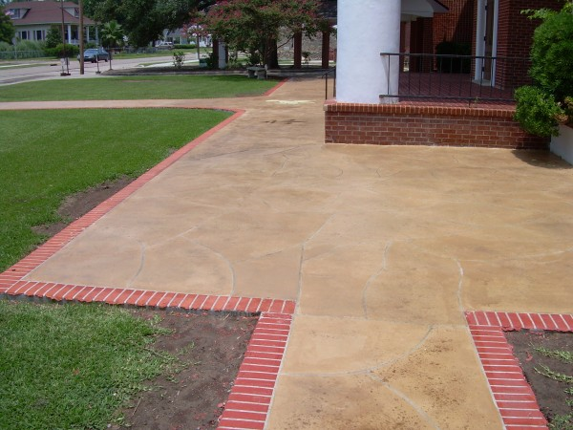
Custom Floor Overlays
Worship Centers

Slide 37
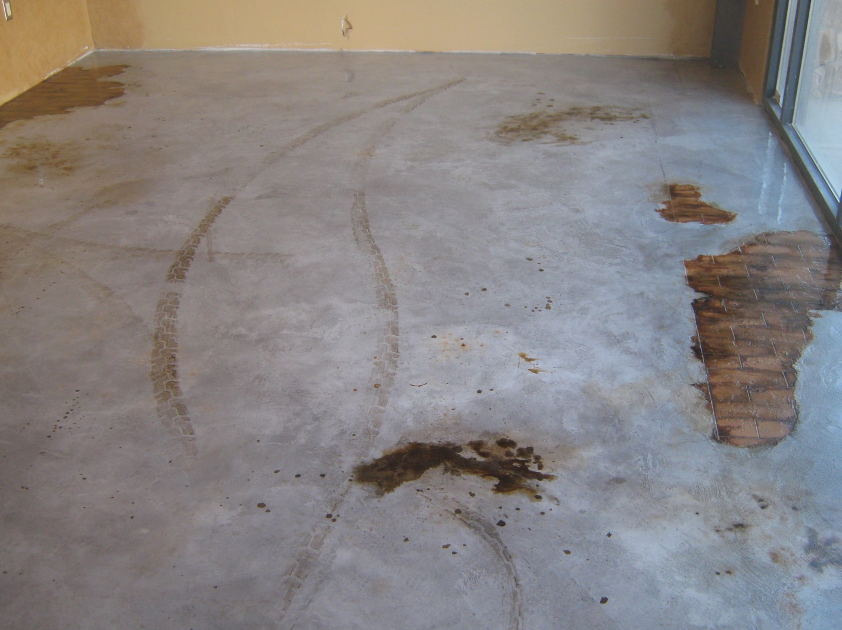
Custom Floor Overlays
Artistic Design

Slide 38
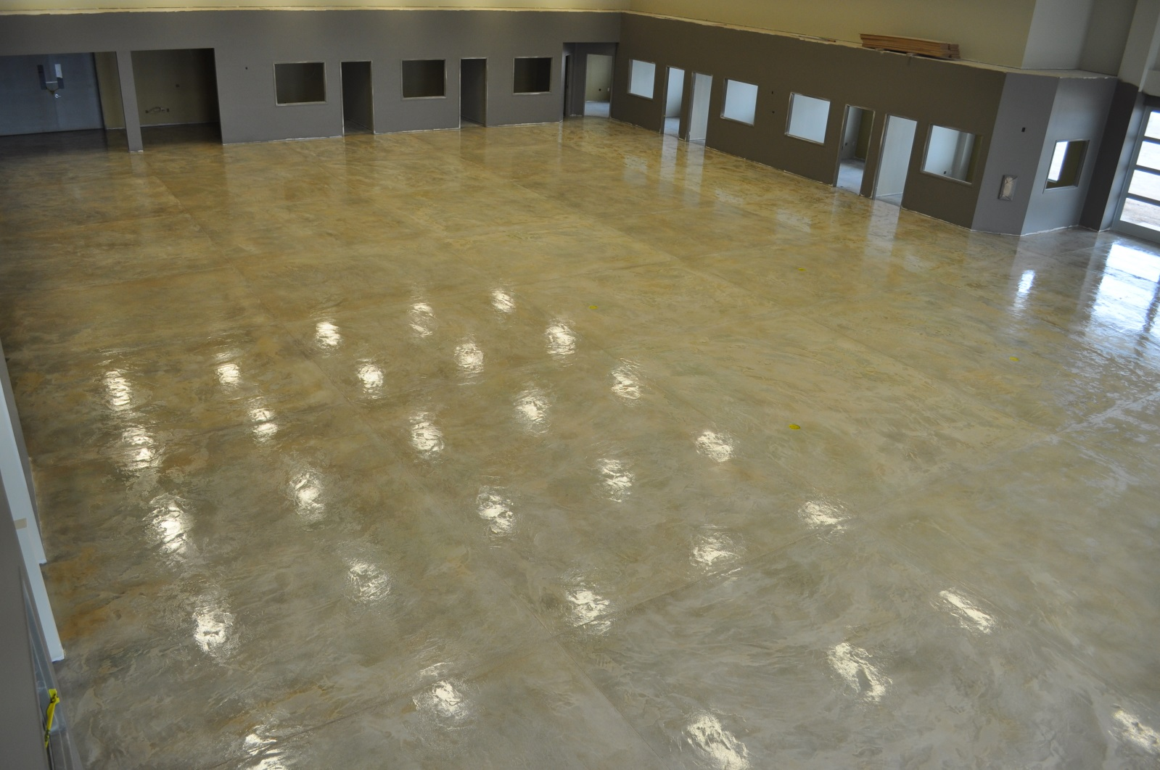
Custom Floor Overlays
Cost Effective Floor Overlay - After

Slide 39
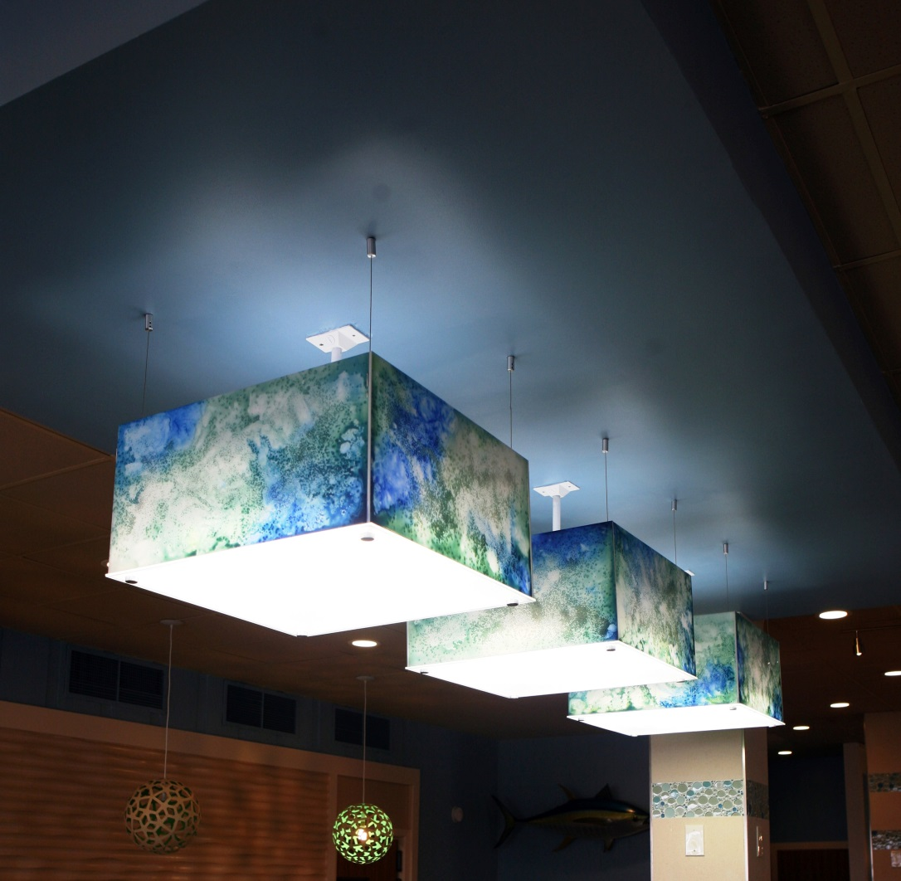
Custom 3D Finishes
Custom Color for Acrylic Lighting

Slide 40
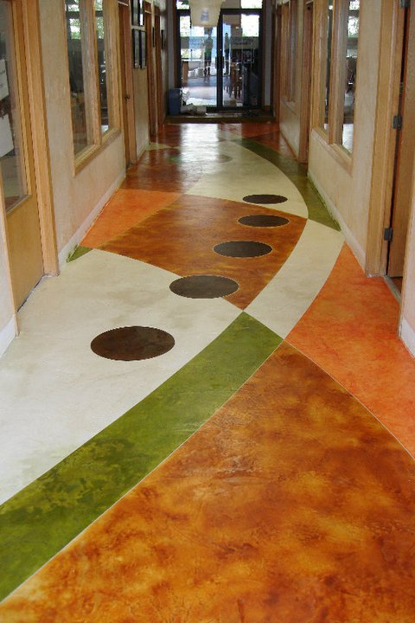
Custom Floor Overlays
Custom Floor Stains

Slide 41
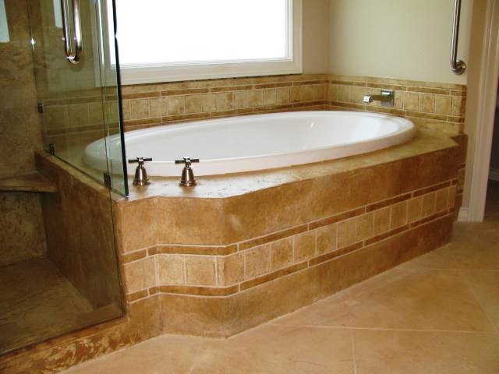
Bathroom Makeovers
Soak In This

Slide 42
Custom Floor Overlays
Designed to be Durable

Slide 43
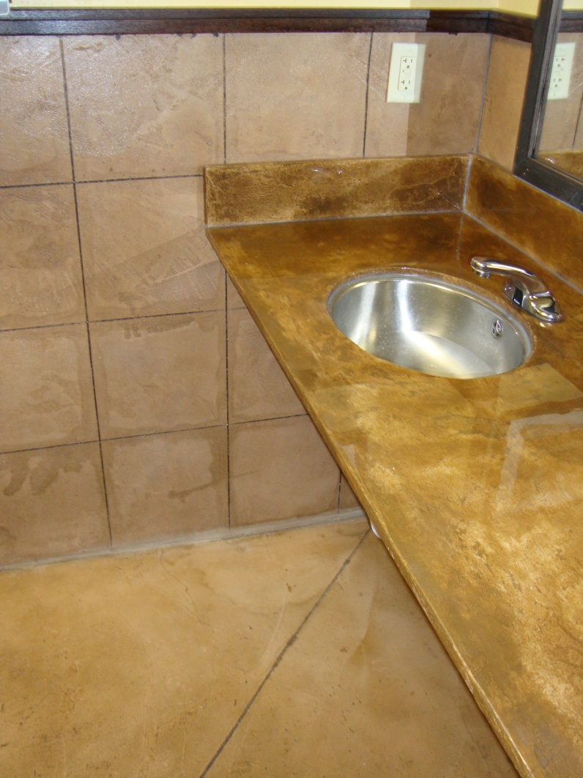
Custom Wall Finishes
Easy Care Commercial Bathroom Wall

Slide 44
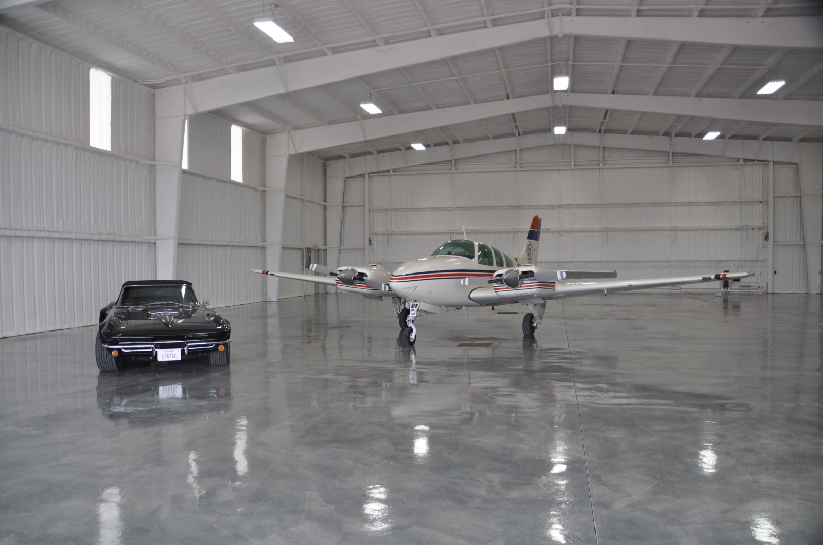
Real MetalliX Epoxy Floors
MetalliX Hanger - Largest in USA

Slide 45
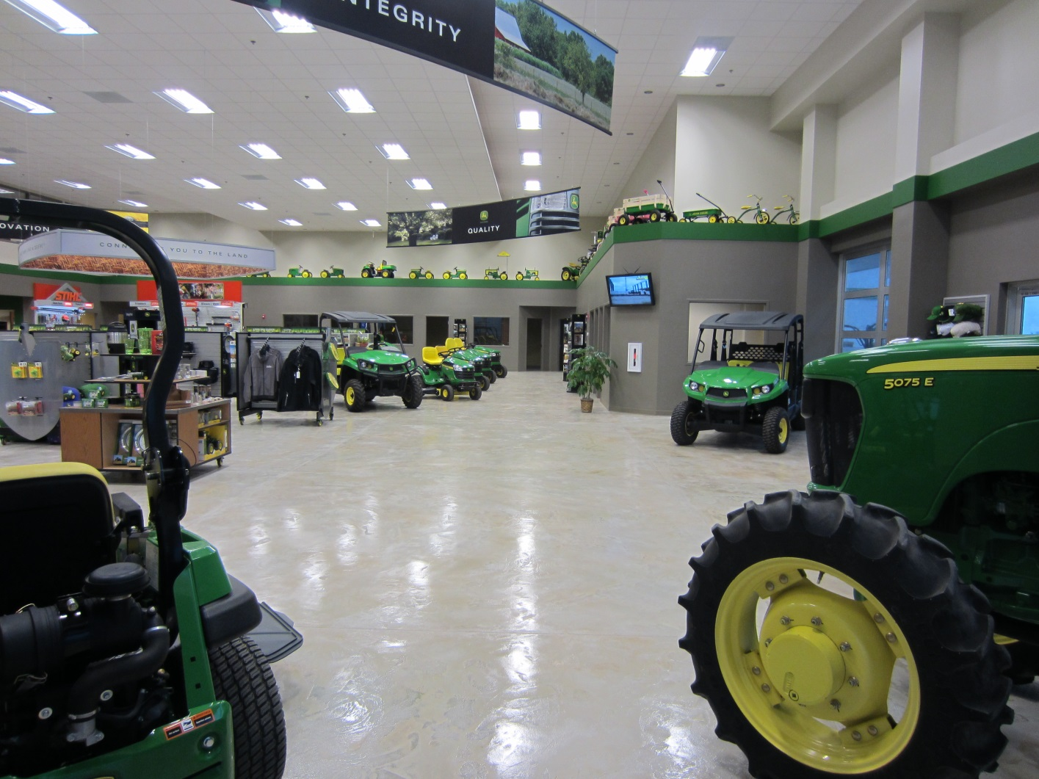
Custom Floor Overlays
Durable for John Deere Equipment

Slide 46
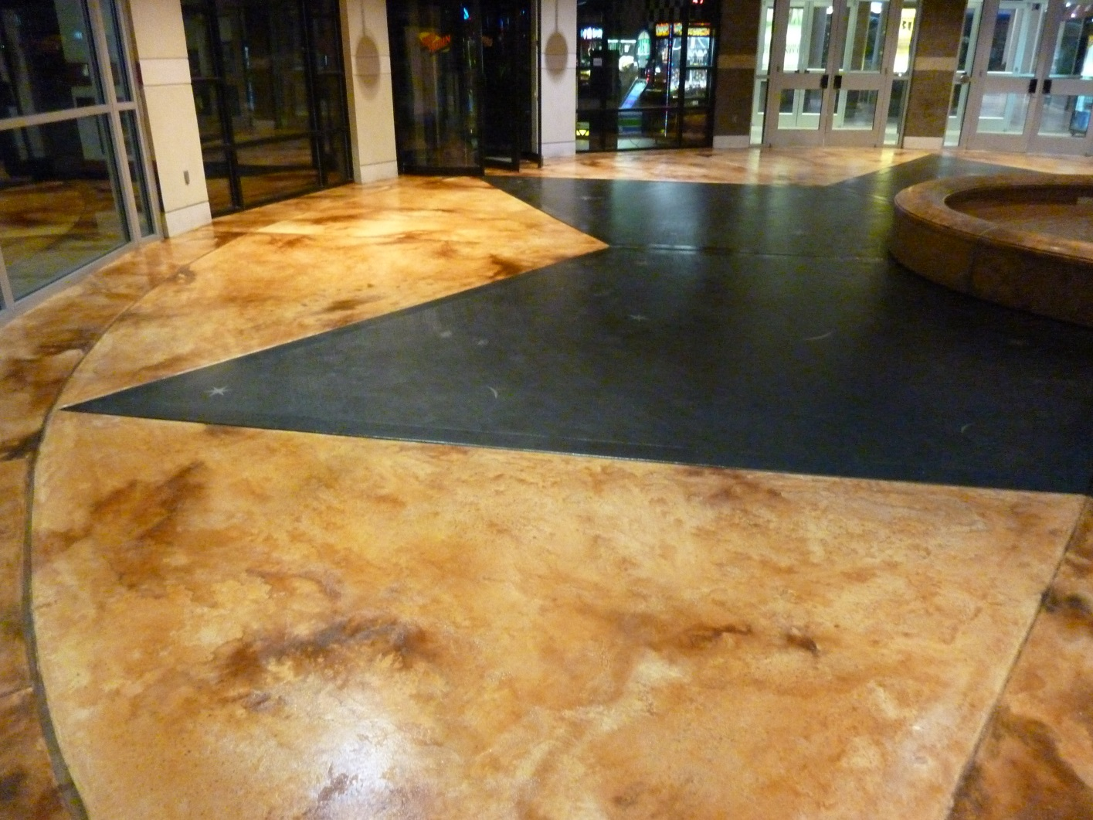
Custom Floor Overlays
Durable for Retail Centers

Slide 47
Exterior Floor Overlays
Extreme Makeover Home Edition TV Show

Slide 48
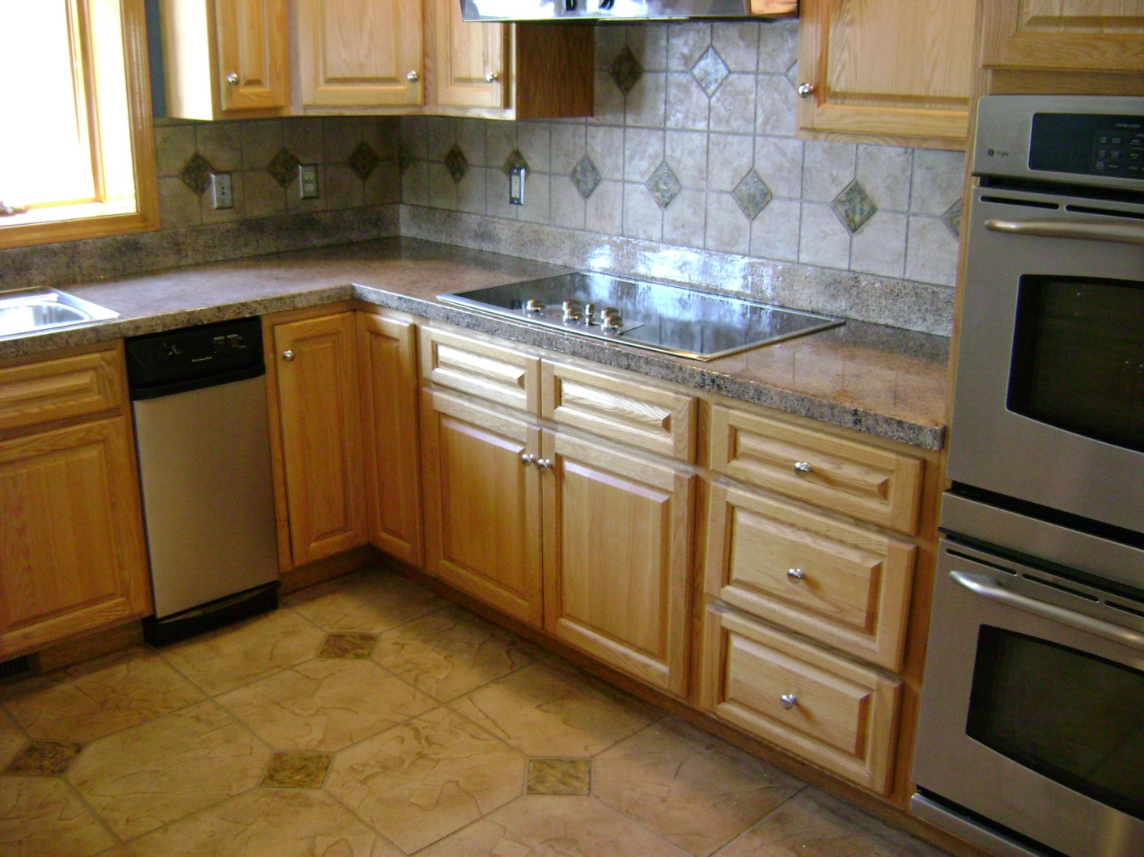
Custom Countertops
Countertop and Splashes

Slide 49
DECORATIVE COATINGS
Overlays – Epoxies – Stains – Sealers
COUNTERTOPS
TABLE TOPS
VANITIES
INTERIOR - EXTERIOR FLOORS
INTERIOR - EXTERIOR WALLS
3D & ART
Residential – Commercial -- Industrial

Slide 50
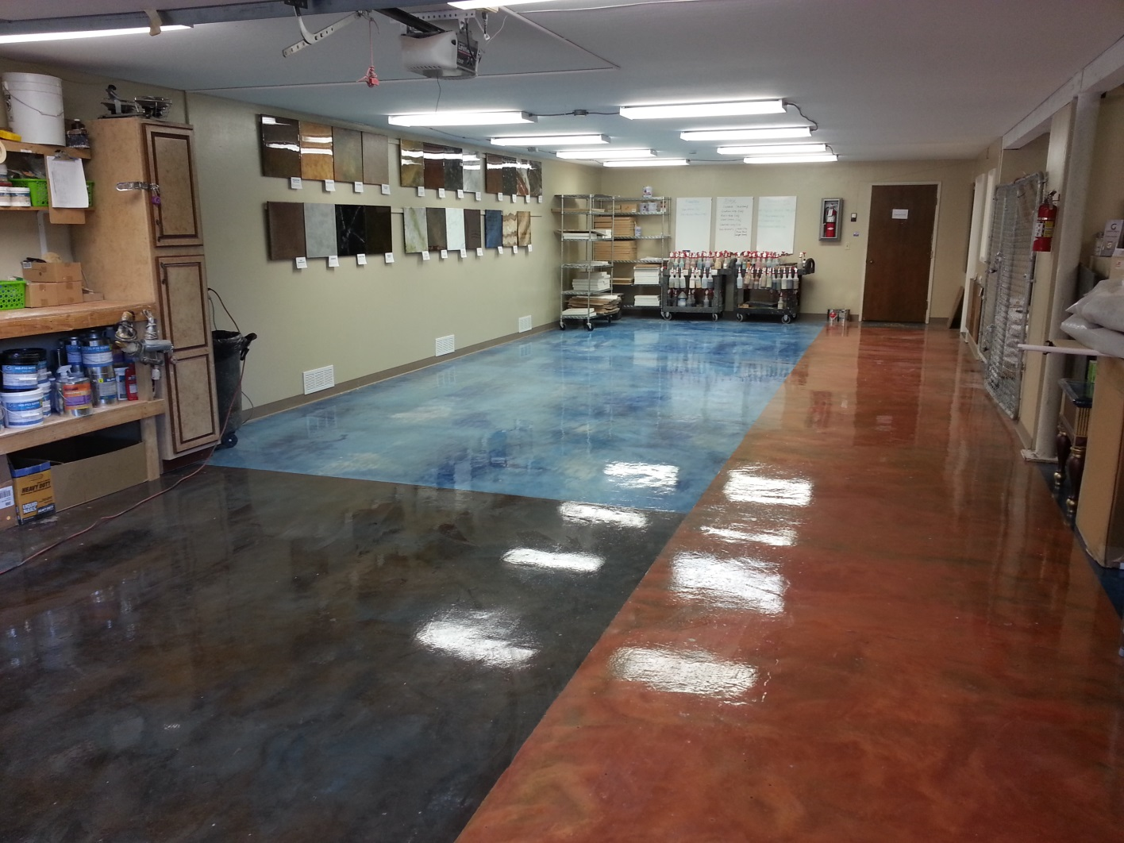
Real MetalliX Epoxy Floors
Real MetalliX Floor

Slide 51
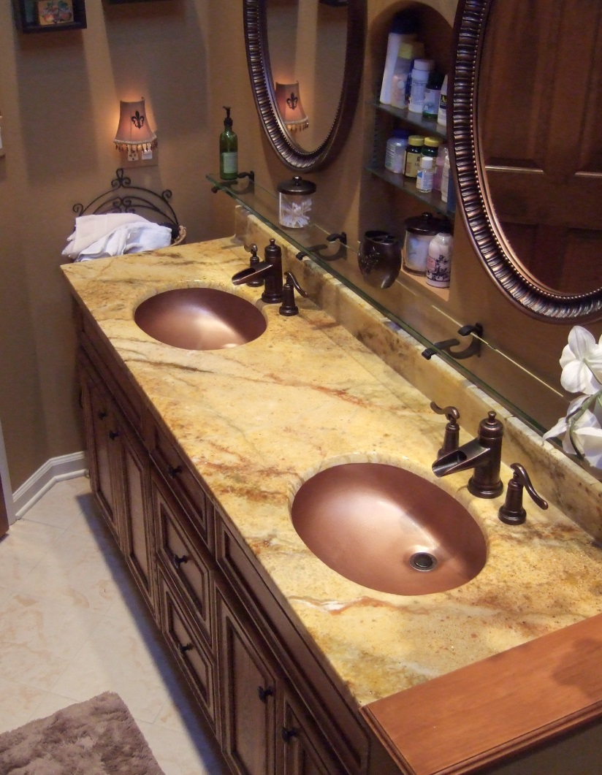
Residential Bath Vanities
Dual Sink Vanity

Slide 52
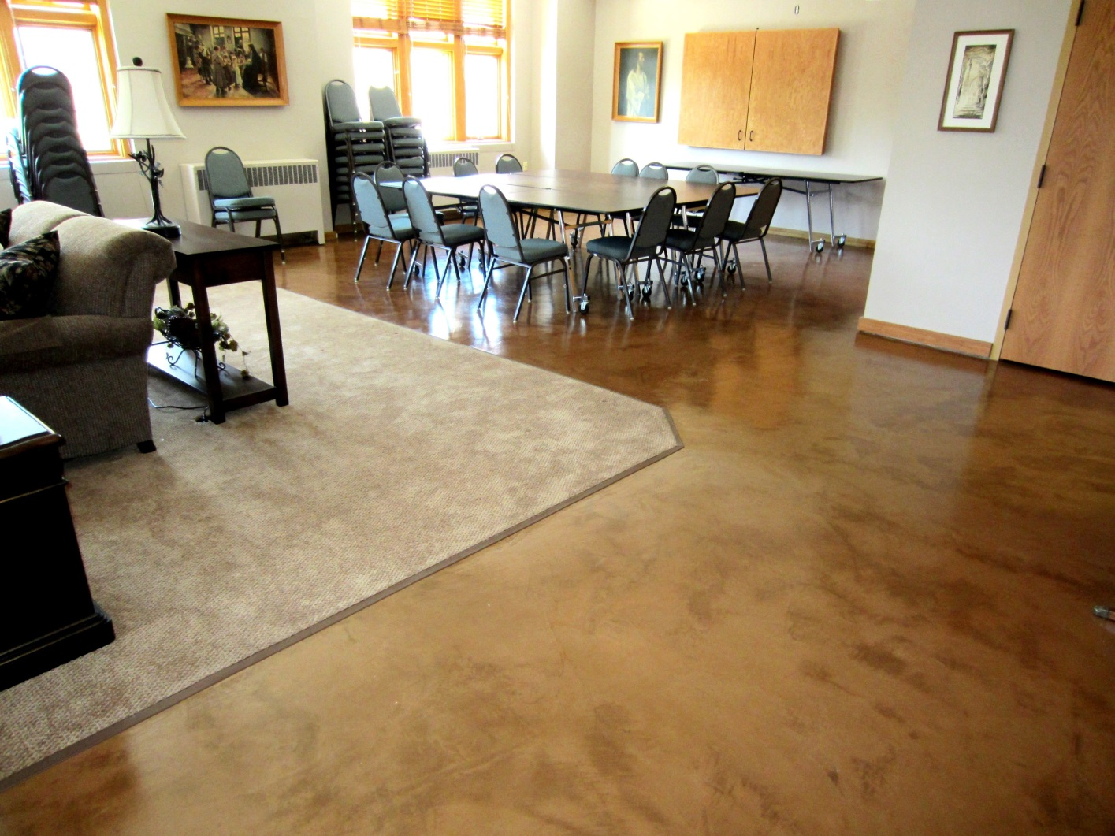
Custom Micro-Top Floor
Micro-Topping Dyed

Slide 53
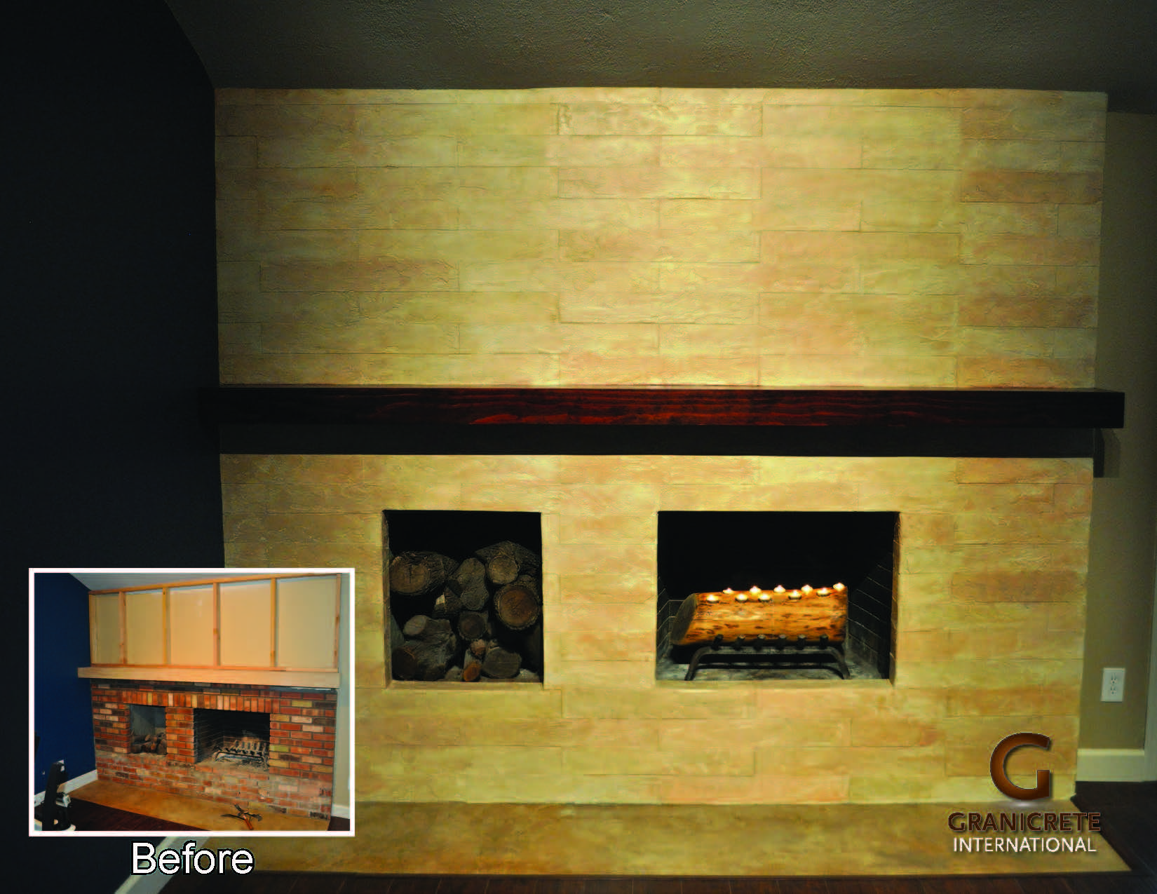
Fireplace Finishes
Transform Fireplace Walls

Slide 54
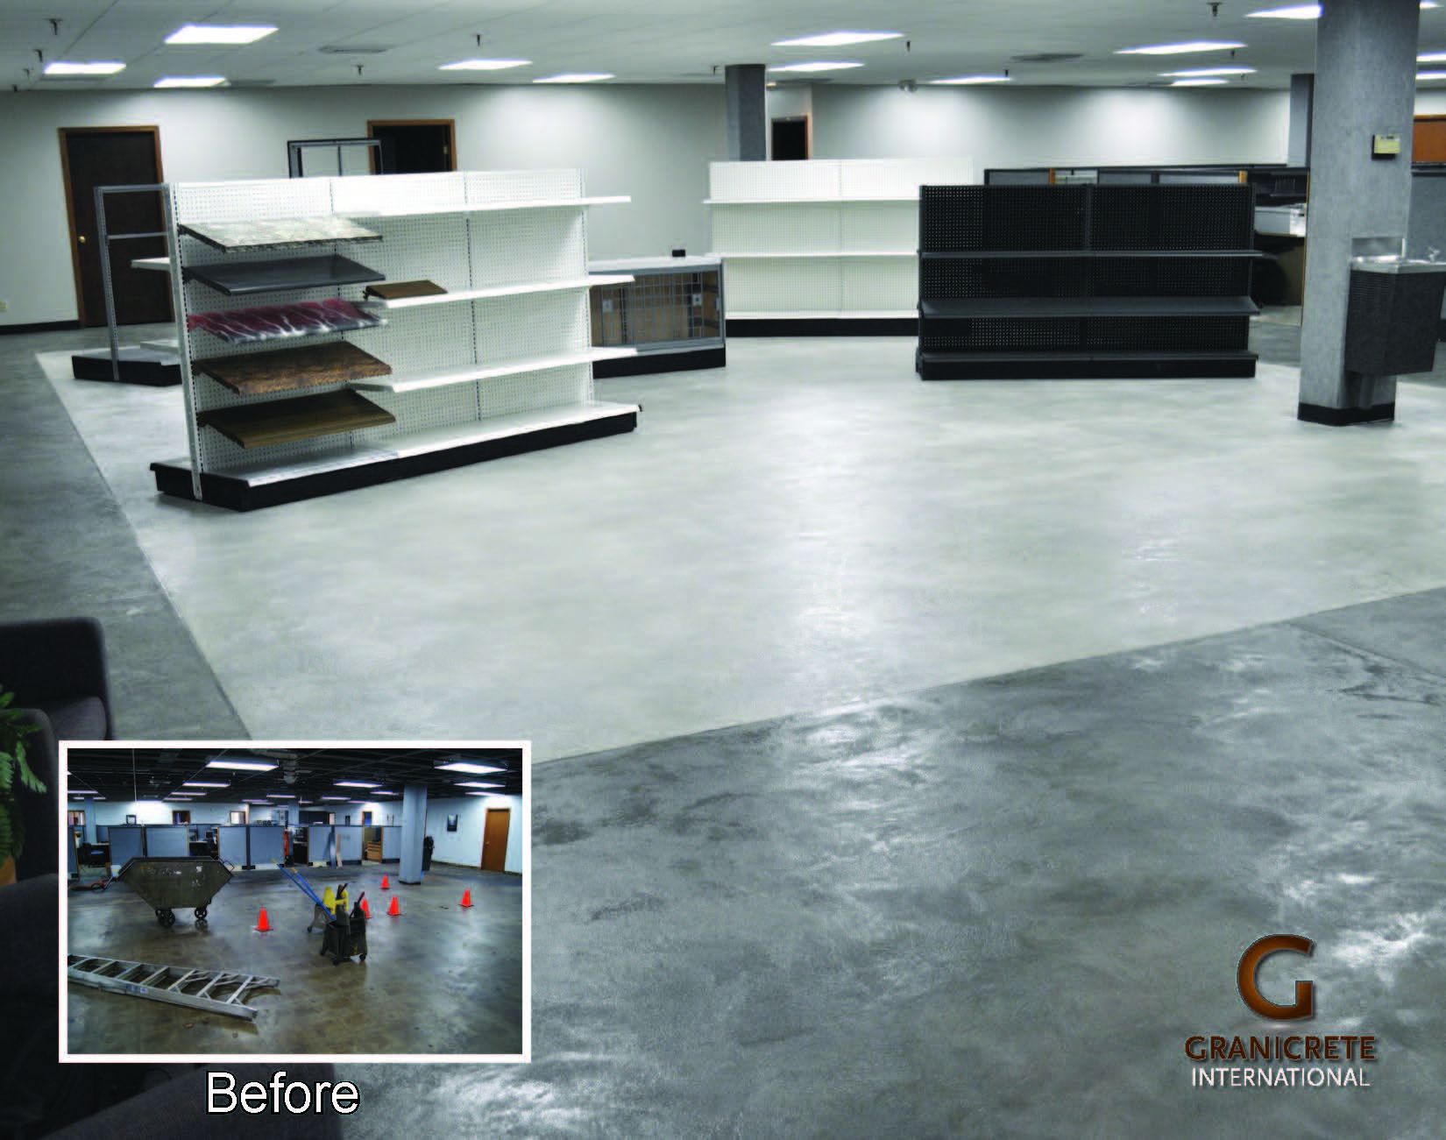
Custom Floor Overlays
Excellent for Commercial Traffic

Slide 55
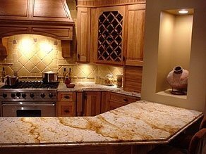
Custom Countertops
Countertops to Match Your Decor

Slide 56
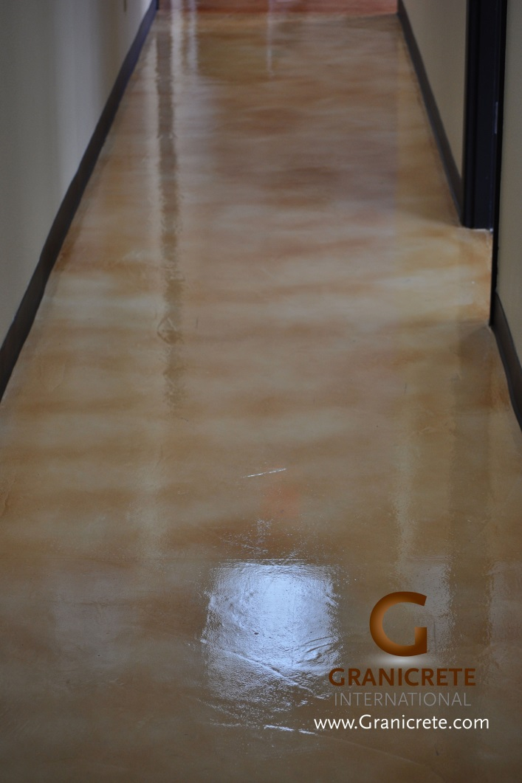
Custom Micro-Topping
Easy Care Flooring

Slide 57
Custom Floor Overlays
Great in Galleries

Slide 58
Custom Wall Finishes
Custom Countertop and Wall

Slide 59
Custom 3D Finishes
Highly Authentic Stone Color Finishes

Slide 60
Custom Floor Overlays
Gymnasium Durable

Slide 61
Residential Bath Vanities
Custom Handcrafted Vanity Tops

Slide 62
Custom Floor Overlays
Hardy for Showrooms

Slide 63
Custom Floor Overlays
High Traffic Durability

Slide 64
Custom Wall Finishes
Designer Wall

Slide 65
Custom Floor Overlays
Large Tile Finish at Fraction of Cost

Slide 66
Exterior Floor Overlays
Custom Stone Patios

Slide 67
Custom Floor Overlays
Meets USDA Compliance for Restaurants

Slide 68
Residential Bath Vanities
Classy

Slide 69
Custom Countertops
House Crashers TV Show

Slide 70
Custom Countertops
Granite Look with Custom Chisel Edge

Slide 71
Custom Micro-Top Floor
Micro-Top Flooring for Offices

Slide 72
Custom Countertops
Custom Concrete Countertops Inspired by Natural Stone

Slide 73
DECORATIVE COATINGS
Overlays – Epoxies – Stains – Sealers
COUNTERTOPS
TABLE TOPS
VANITIES
INTERIOR - EXTERIOR FLOORS
INTERIOR - EXTERIOR WALLS
3D & ART
Residential – Commercial -- Industrial

Slide 74
Custom Floor Overlays
Resists Salon Chemicals

Slide 75
Custom Floor Overlays
Stands Up to Heavy Equipment

Slide 76
Custom Countertops
Custom Stone Finishes

Slide 77
Custom Floor Overlays
Countertop and Pony Wall

Slide 78
Real MetalliX Epoxy Floors
Real MetalliX Floors

Slide 79
Custom Wall Finishes
Exterior Wall Finishes

Slide 80
Custom Tables
Boardroom Tables

Slide 81
Custom Wall Finishes
Slate Office Wall Close Up

Slide 82
Exterior Floor Overlays
Great for Patios and Porches

Slide 83
Custom Floor Overlays
Stencil and Design Ready

Slide 84
Fireplace Finishes
Stunning Fireplace

Slide 85
Custom Countertops
Custom Edges

Slide 86
Exterior Floor Overlays
Big Stone Porches

Slide 87
Custom Commercial Tops
Coffee Bars

Slide 88
Exterior Floor Overlays
Custom Designs

Slide 89
Residential Bath Vanities
Created Around Copper Tones

Slide 90
Custom Countertops
Custom Marble Finishes

Slide 91
Custom Tables
Stone End Tables

Slide 92
Custom Countertops
Chisel Edge and Honed Finishes

Slide 93
Exterior Floor Overlays
Cooling Patio Decks

Slide 94
Residential Bath Vanities
Unlimited Vanity Finishes

Slide 95
Exterior Floor Overlays
Custom Deck Stone Finish

Slide 96
Custom Countertops
Before and After

Slide 97
DECORATIVE COATINGS
Overlays – Epoxies – Stains – Sealers
COUNTERTOPS
TABLE TOPS
VANITIES
INTERIOR - EXTERIOR FLOORS
INTERIOR - EXTERIOR WALLS
3D & ART
Residential – Commercial -- Industrial

Slide 98
Custom Tables
Stone Finished Formal Dining Table

Slide 99
Custom Countertops
Custom Concrete Countertops

Slide 100
Residential Bath Vanities
Adheres Directly On Culture Marble

Slide 101
Custom Countertops
Custom Finishes Right over Laminate

Slide 102
Exterior Floor Overlays
Custom Patios

Slide 103
Custom Countertops
Extreme Makeover TV Show

Slide 104
Art Accents
Artistic Stone Finishes

Slide 105
Exterior Floor Overlays
Custom Throughout

Slide 106
Custom Countertops
Custom Tall Backsplash Too

Slide 107
Custom 3D Finishes
Vertical Use of Overlay

Slide 108
Exterior Floor Overlays
Hot Tire Resistant

Slide 109
Custom Countertops
Luxury Stone Finishes

Slide 110
Exterior Floor Overlays
Custom Stone Finish Patio

Slide 111
Custom Countertops
Show Off Your Kitchen

Slide 112
Custom Countertops
Stunning!

Slide 113
Custom Garage Floors
Chemical Resistant Garage Floor Epoxies

Slide 114
Exterior Floor Overlays
Custom Entry

Slide 115
Custom Countertops
Unlimited Handcrafted Finishes

Slide 116
Real MetalliX Epoxy Floor
MetalliX Floor for Great Garages

Slide 117
Exterior Floor Overlays
Brick Finish Driveway

Slide 118
Real MetalliX Epoxy Floor
Numerous MetalliX Colors

Slide 119
Exterior Floor Overlays
Coats Over Worn and Damaged Kool Deck

Slide 120
DECORATIVE COATINGS
Overlays – Epoxies – Stains – Sealers
COUNTERTOPS
TABLE TOPS
VANITIES
INTERIOR - EXTERIOR FLOORS
INTERIOR - EXTERIOR WALLS
3D & ART
Residential – Commercial -- Industrial

Slide 121
Real MetalliX Epoxy Floor
MetalliX Movement and Design

Slide 122
Exterior Floor Overlays
Driveways Finishes of Your Choice

Slide 123
Exterior Floor Overlays
Easy To Create Patterns

Slide 124
Custom Interior Overlays
Custom Floor With Accents

Slide 125
Exterior Floor Overlays
Entry to Match Natural Stone Walls

Slide 126
Custom Tables
Stone Finish Breakfast Tables

Slide 127
Real MetalliX Epoxy Floor
MetalliX Floor - Metal in Motion

Slide 128
Exterior Floor Overlays
Patios To Enjoy

Slide 129
Exterior Floor Overlays
Expressive Patio

Slide 130
Art Accents
Acrylic Art

Slide 131
Exterior Floor Overlays
Flagstone at a Fraction of the Price

Slide 132
Custom Interior Overlays
Luxury Home Elegance

Slide 133
Custom Micro-Toppings
Micro-Topping Floor Finishes

Slide 134
Exterior Floor Overlays
Front Entry

Slide 135
Exterior Floor Overlays
Front Steps

Slide 136
Custom Interior Overlays
Easy To Clean

Slide 137
Exterior Floor Overlays
Inviting...

Slide 138
Exterior Floor Overlays
Transform Your Driveway

Slide 139
Art Accents
Custom Acrylic Art

Slide 140
Exterior Floor Overlays
Extreme Makeover Home Edition

Slide 141
Custom Interior Overlays
Stained Overlay

Slide 142
Exterior Floor Overlays
Cool To The Foot!

Slide 143
Custom Tables
Custom Checkerboard Table

Slide 144
DECORATIVE COATINGS
Overlays – Epoxies – Stains – Sealers
COUNTERTOPS
TABLE TOPS
VANITIES
INTERIOR - EXTERIOR FLOORS
INTERIOR - EXTERIOR WALLS
3D & ART
Residential – Commercial -- Industrial

Slide 145
Exterior Floor Overlays
Transform Your Driveway

Slide 146
Custom Interior Overlays
Custom Checkerboard Stone Floor

Slide 147
Custom Tables
Modern Concrete Dining Table

Slide 148
Custom Interior Overlays
Decorative Concrete Modern Finishes

Slide 149
Custom Tables
Custom Onyx Finish Conference Tables

Slide 150
Custom Micro-Toppings
Easy Clean Kitchen Floors

Slide 151
Custom Interior Overlays
Easy Cleaning Flooring

Slide 152
Custom Floor Overlays
DG - W - GARAGE

Slide 153
Wall Art
Modern Art

Slide 154
Custom Interior Overlays
Formal Dining Floors

Slide 155
Custom Tables
Stone Finish Desks

Slide 156
Custom Interior Overlays
Our Concrete Overlay Can Even Look Like Wood

Slide 157
Custom Micro-Toppings
Rich Blue Micro-Topping

Slide 158
Exterior Floor Overlays
Ugly Concrete Becomes Granicrete

Slide 159
Custom Interior Overlays
Ugly Concrete Becomes Beautiful

Slide 160
Wall Art
Custom Headboards

Slide 161
Exterior Floor Overlays
Enhanced Curb Appeal

Slide 162
Real MetalliX Epoxy Floors
Real MetalliX Epoxy

Slide 163
Custom 3D Finishes
Vertical Use of Overlay 1

Slide 164
Exterior Floor Overlays
Custom Easy To Care Driveway

Slide 165
Custom Floor Overlays
Etch or Stencil Capable

Slide 166
Custom Countertops
High-End Vacations Rentals

Slide 167
Custom Floor Overlays
Durable & Low Maintenance

